Slide 1


UC Tech Conference
July 16th, 2019
Notes:
To add slide numbers: Go to Insert→ Header & Footer → Check Slide Number Box → Apply to All

Slide 2
Contents
Dasher Introduction & UCOP Agreement Overview
Enterprise Networking Case Studies
Data Center and Cloud Case Studies

Slide 3
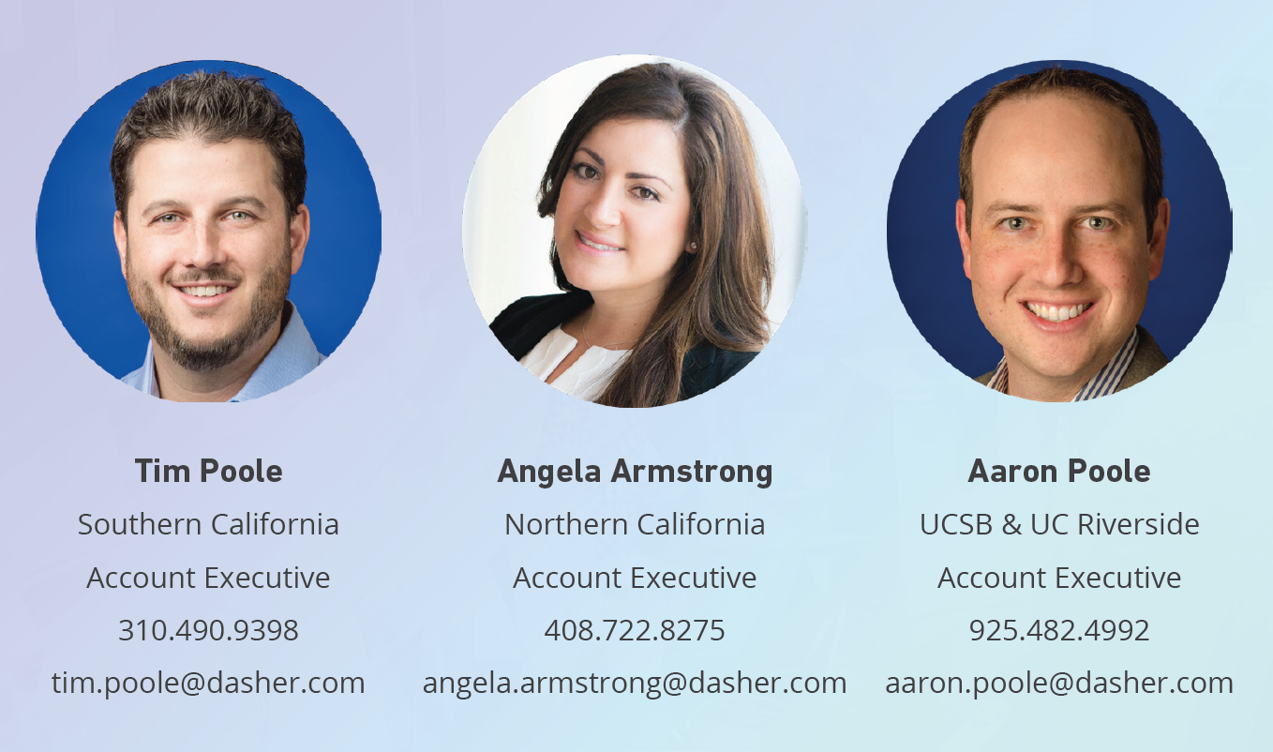
Meet your Dasher Account Team

Slide 4
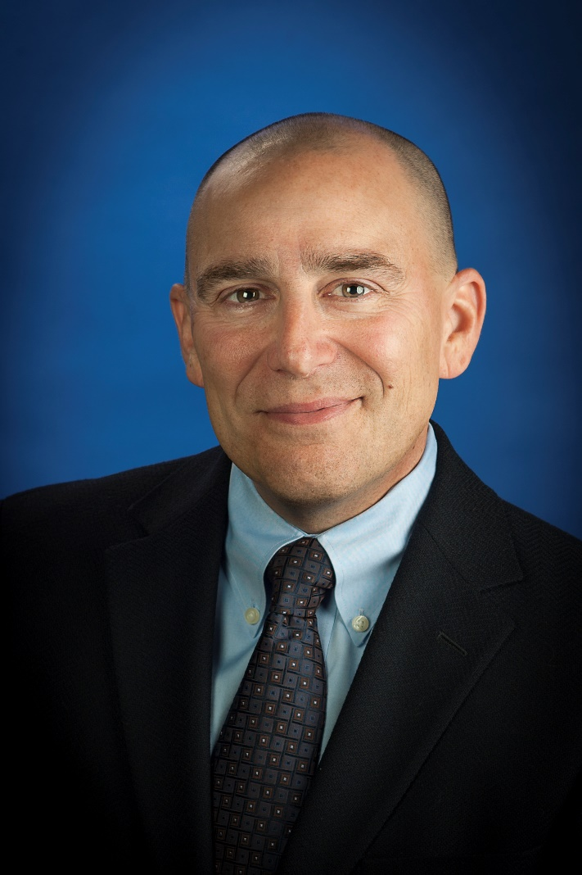

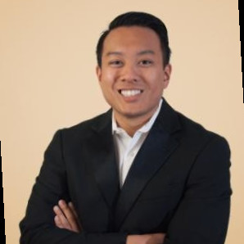
Meet your Dasher Engineering Team
Chris Saso
CTO
Chris.saso@dasher.com
Brandon Pitta
Solution Architect
Data Center and Cloud
Brandon.pitta@dasher.com
Sean Vo
Solution Architect
Networking and Cyber Security
Sean.vo@dasher.com

Slide 5


We Take IT Personally
Notes:
To add slide numbers: Go to Insert→ Header & Footer → Check Slide Number Box → Apply to All

Slide 6
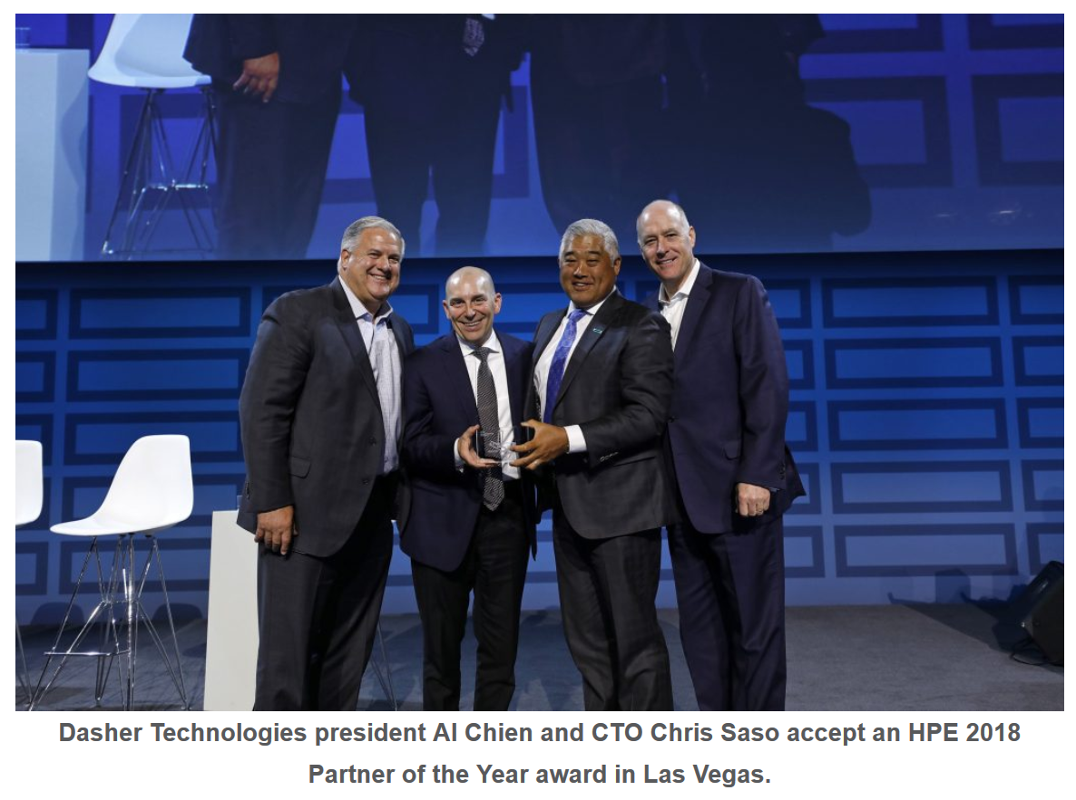
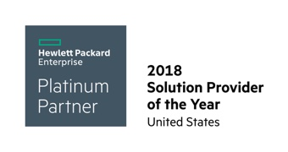
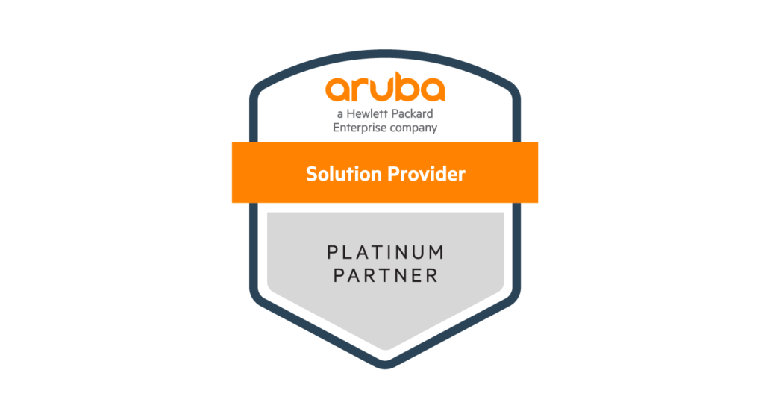
HPE 2018 US Solution Provider of the Year
https://www.dasher.com/news/dasher-technologies-wins-hewlett-packard-enterprise-partner-of-the-year-award/

Slide 7
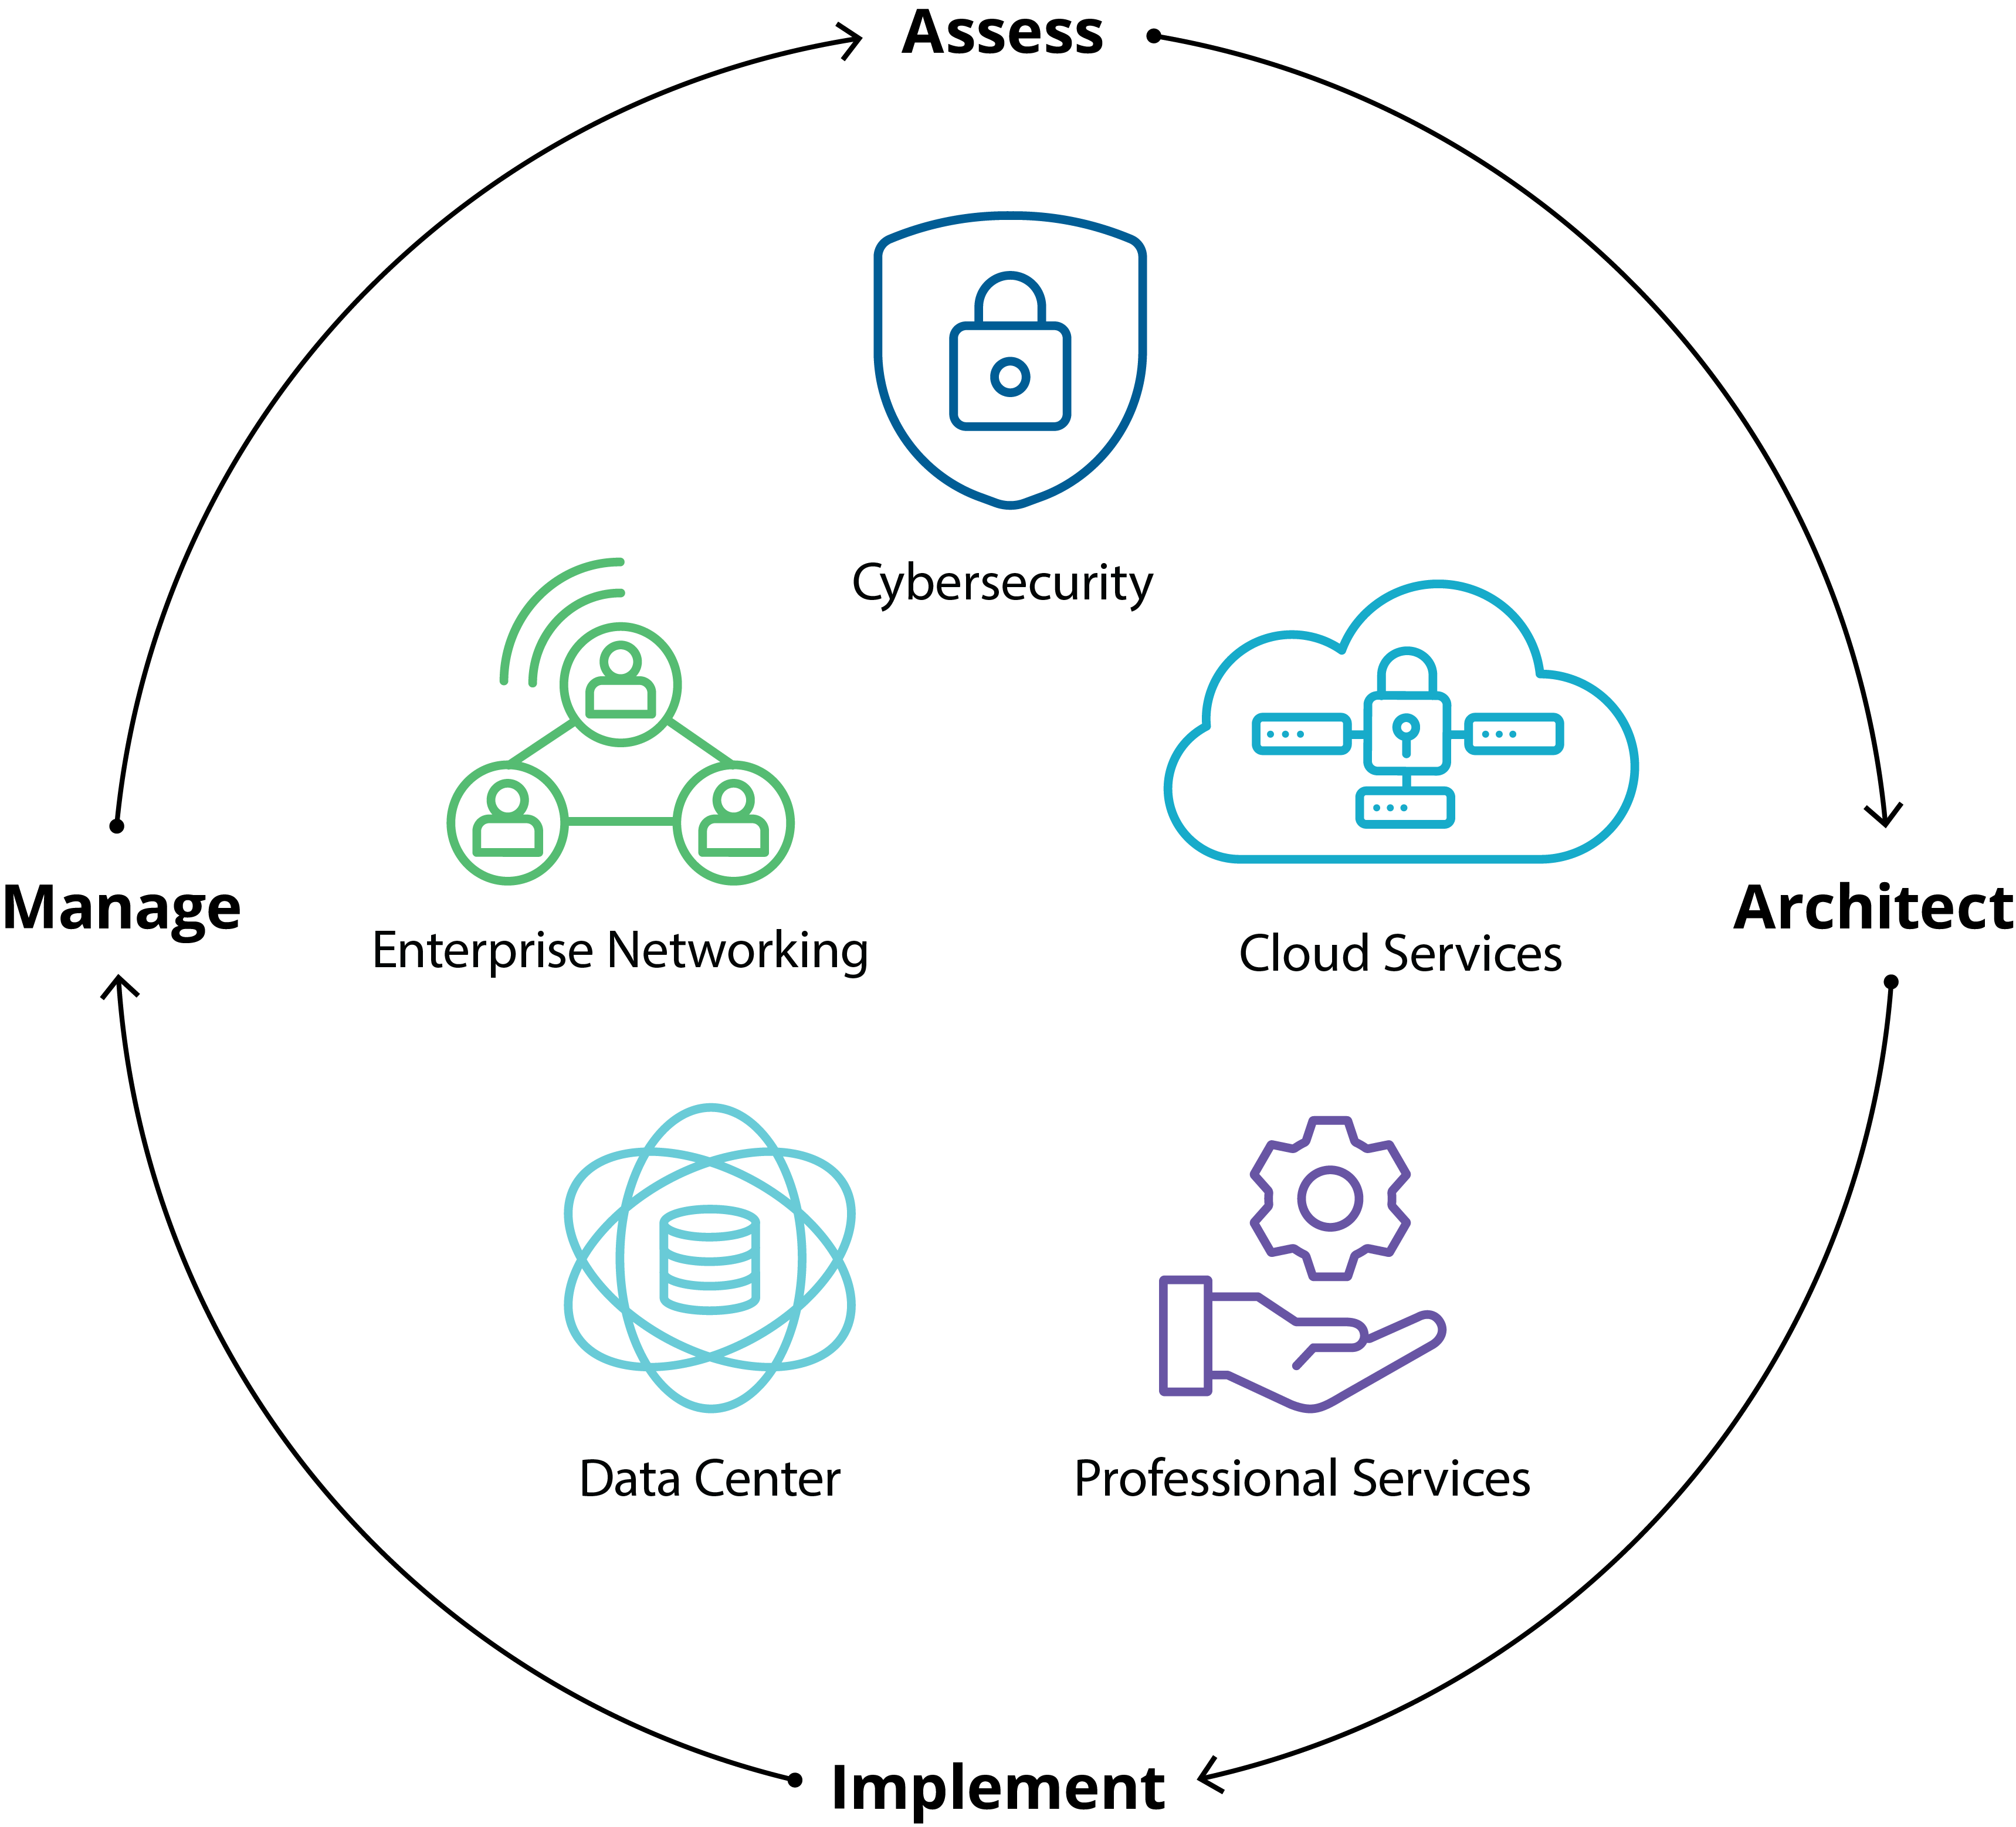
Value Added Resource
We take IT personally
20 years of experience, woman-owned business
2-to-1 engineer-to-account executive ratio
Fully equipped demo lab for proof-of-concept and trails
Integration center enables configuration and pre-assembly
Vendor agnostic approach, let Dasher be your advisor
International logistics & remote services
Notes:
CHRIS

Slide 8
Executive Summary – Dasher Services
Enterprise and Data Center Networking to securely connect your staff with your other offices and the internet
  Assessment, Architecture and Implementation of LAN, WAN, Wired and Wireless Solutions
  Enterprise Wireless and Wired NAC Solutions Based on Aruba ClearPass
  SD-WAN Solutions to lower connectivity costs and increase reliability and QOS
CyberSecurity Solutions
  Based on the CIS Top 20 Protocols Dasher can Assess, Architect and Deliver Comprehensive CyberSecurity Solutions
  Next Generation Firewall
  Cloud Workload Security
  Vulnerability and Penetration Testing
  Network and User Visibility and Management (UEBA)
Cloud Services
  Design Infrastructure and Security Solutions for the Public Cloud just like we have been doing for Private Clouds for 20 years
  Leverage cloud solutions offered by leading IT vendors for Cybersecurity and storage
  Move from server virtualization to workload virtualization (containers)
  Architect Hybrid IT Solutions leveraging Public and Private Clouds
Scalable Server and Storage Solutions
  High Performance computing solutions based on scale-out compute and AI and Machine Learning Technologies such as GPU
  Next generation Flash and NVME based Storage including Software Defined Storage Solutions
  Hyper Converged and Virtualized Solutions
  Backup and Recovery Solutions include BC/DR Solutions

Slide 9
Dasher’s Engineering Organization
Key:
Campbell PNW
SoCal Florida first.last@dasher.com
Chris Saso
CTO
408.390.7276
Josh Close
VP of Engineering
206.708.9345
Data Center and Cloud Services Team
Cybersecurity and Enterprise Networking Team
Ryan Ollenburger
Sr. Solution Architect
831.212.2207
Bill Jones
Sr. Solution Architect
503.308.3544
Michael Westerfield
Sr. Solution Architect
407.558.9736
Ted Dasher Jr.
Sr. Solution Architect
205.901.4601
Jeff Davitt
Sr. Solution Architect
407.212.0319
Carol Swink
Sr. Solution Architect
408.819.1121
Ashish Shah
Sr. Solution Architect
408.409.2800
Brandon Pitta
Solution Architect
408.679.4396
Leb Tran
Solution Architect
408.761.5461
Kellen Christensen
Sr. Solution Architect
205.707.1826
James Delancey
Sr. Solution Architect
408.442.4375
Brynden Hutmacher
Sr. Solution Engineer
831.239.9313
Mitchell Hurd
Solution Architect
408.781.6148
Sean Vo
Solution Architect
301.606.0426
Denis Kazakov
Solution Engineer
408.497.5115
Devin Valdez
Solution Engineer
408.497.9794
Fahad Tariq
Sr. Solution Engineer
408.819.1569
Robert Glover
Sr. Solution Engineer
408.761.7803
Markus Lettner
Integration Engineer
831.345.3622
John Stephens
Solution Engineer
408.313.7680
David Barajas
IT Manager
408.761.0351
Marlene Rogers
Project Manager
408.489.1476
Julie Gibson
Sr. Project Manger
408.568.7760

Slide 10


Completing the circle
VENDOR SUPPORT ESCALATIONS AND support@dasher.com
DEDICATED SUPPORT RENEWALS TEAM
DELIVER SUPPORT ASSESSMENTS
PROVIDE SUPPORT AGREEMENTS FOR ALL DASHER VENDORS
DEMO GEAR AND PROOF-OF-CONCEPTS
TECHNOLOGY RAPID FIRE SESSIONS

Slide 11
UCOP Purchasing Agreement
#2018.000116
ucop@dasher.com
Notes:
To add slide numbers: Go to Insert→ Header & Footer → Check Slide Number Box → Apply to All

Slide 12
Highlights of the UCOP Contract
Provides significant discounts off of list price
5-year term with ability to extend at one year intervals for an additional 5 years
Dasher is developing an e-commerce site for online transactions
No minimum commits (Significant discounts whether you by 1 to 5000)
Contract applies to all UC entities on this site:
  https://www.universityofcalifornia.edu/uc-system/parts-of-uc
Aggressive Pro Services Rates are included in the agreement
Response SLAs:
  -Return client calls within 4 business hours
  -Quote turnaround within 1 business day for standard requests
Dasher sponsors educational UC IT Tech Days – such as today!

Slide 13
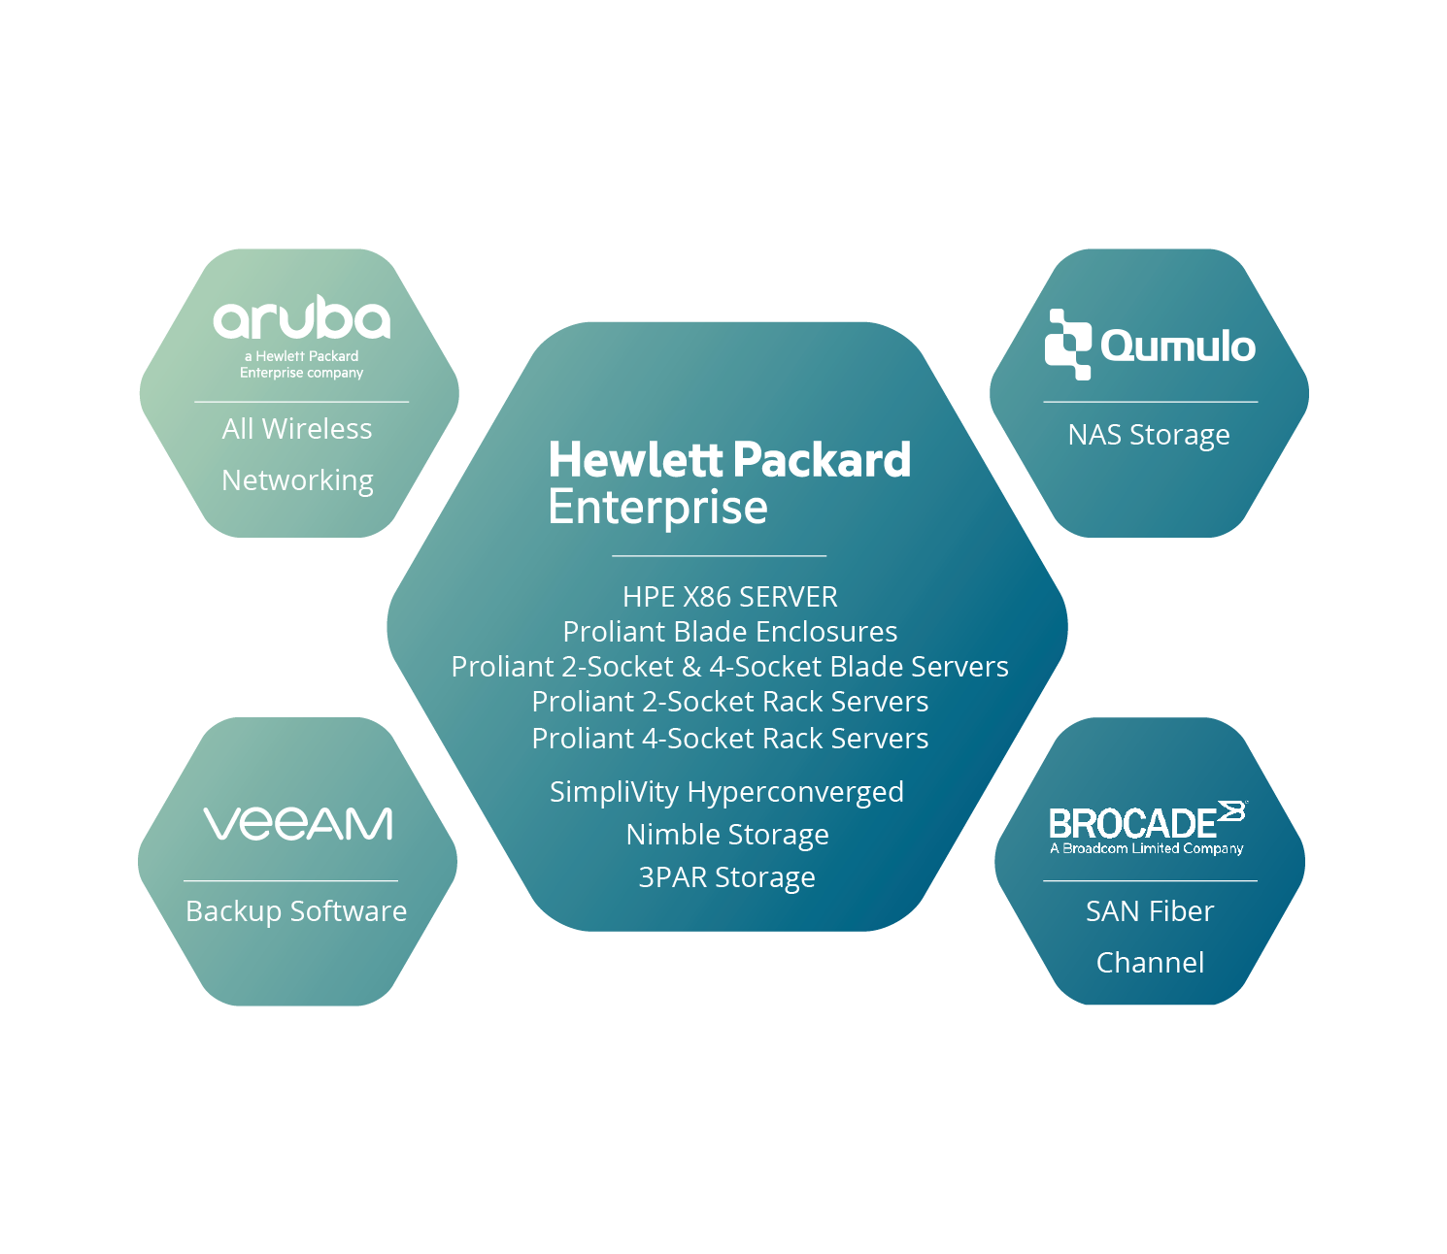

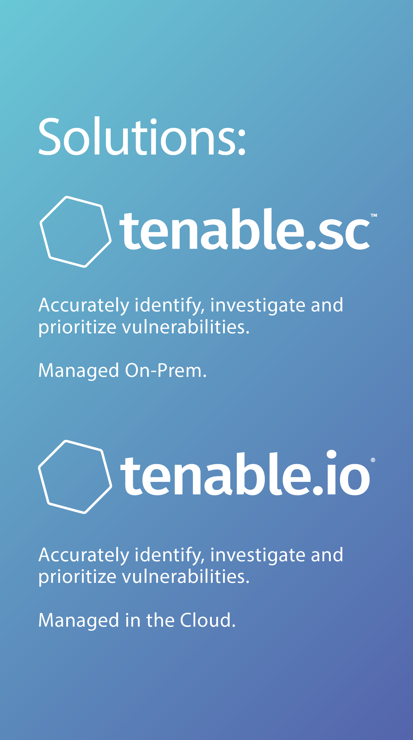
UCOP Technology Solutions from Dasher Technologies

Slide 14
Networking Solutions

Slide 15





K-12 Unified School District Aruba Wireless
Implement best practices for Aruba Wireless and deploy ClearPass for Wireless 802.1x + Guest Portal
  The school district had 40+ locations using an Aruba Wireless solution that was configured sub-optimally.
  The IT team needed to securely onboard a huge number of wireless devices that were recently procured:
    Chromebooks, iPads, MacBooks, PC Laptops, Mobile Devices, and Apple TV’s.
  Management of the existing wireless was centralized for larger schools that had dedicated wireless controllers, but there were many smaller schools that had individual Aruba “Instant” clusters that needed to be managed.
  Timing was critical because all work had to be completed before school started in the Fall.
Assess
  Dasher designed a solution to distinguish access requirements between the different types of devices (above) and different types of users (students, staff, IT administrators, guests) while maintaining a concise number of SSID’s using Role-Based Access Control, RBAC.
  The complete solution included Dasher Pro Services to configure AirWave for management of the Aruba Instant clusters.
Plan & Design
    Successfully implemented a secure and redundant wireless 802.1x solution using ClearPass and a Guest Access Portal, and simplified management and monitoring of the wireless environment using AirWave.
    Provided on-site training of new systems for local IT team to manage their infrastructure moving forward.
Implement
Train
Optimize
The IT team was able to onboard the devices by the start of school!
Using Airwave, the IT team was able to provide the level of Monitoring and Management required to onboard new devices effectively.
Dasher was awarded a multi-year contract to partner with the school district to manage future change and risk/
Business Result:

Slide 16
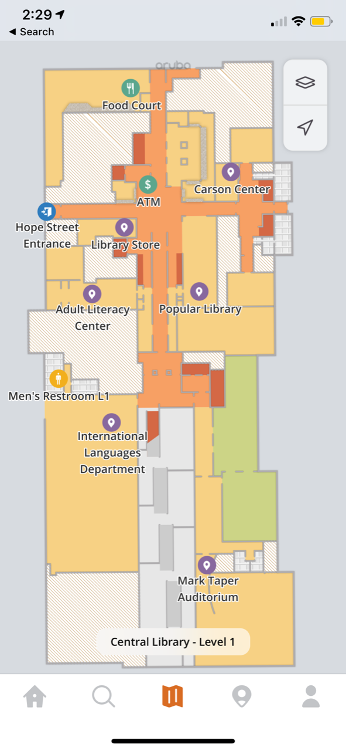
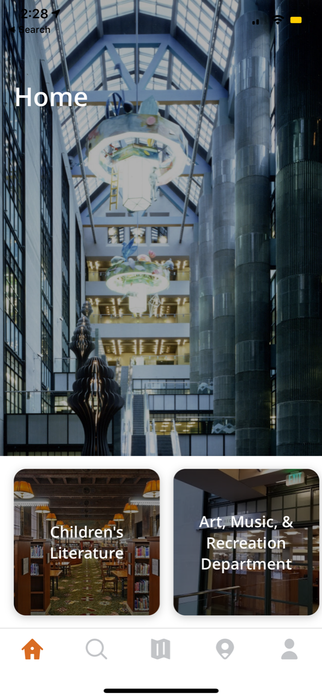
LA Public Library ArubaOS 8, ClearPass, and Meridian
Designed and implemented a full suite of Aruba Wireless and Security products.
  The Library had 72 branches with individual Aruba Instant Clusters for each site.
  Although each branch had a 1Gbps WAN circuit, each branch used an inline captive portal appliance with a 10 Mbps interface.
  There were 6 different SSID with static VLANs for access control, which is beyond the 2 to 3 recommended for performance.
  No good application existed for the public.
Assess
  Dasher designed a solution to increase security posture while maintaning minimal number of SSID's using RBAC.
  The solution included removal of the existing captive portal appliances to allow full usage of bandwidth and centralized management of the wireless infrastructure.
Plan & Design
    Successfully implemented ArubaOS 8 and converted all instant clusters to campus AP's with AP Groups for each branch with RBAC for each use case.
    Meridian wayfinding infrastructure and mobile app launched.
    ClearPass Guest Captive Portal replaced existing tool.
Implement
Train
Optimize
Simplified management of the wireless enterprise and increased security with wireless 802.1x.
Success in utilizing full bandwidth capabilities that each site had.
Public application for the library now available.
Dasher was awarded another proejct to implement wired 802.1x among other future projects.
Business Result:

Slide 17
Data Center and Cloud Solutions

Slide 18

Winning with

Slide 19



EPYC™ by the numbers
  HPE ProLiant DL325
  Gen10 Server
  HPE ProLiant DL385
  Gen10 Server
  HPE Apollo 35 Server
  Dense AMD EPYC™ server for HPC
Delivering 2P performance at 1P economics
  A new formula for server virtualization
32
128
8
2^{TB}
24, 16, 8
cores per CPU
PCIe® Gen 3 lanes
in a single CPU
Memory channels per CPU
RAM per
CPU
Wide range of cores
without sacrificing features
Largest I/O
capacity¹
Industry leading memory bandwidth²
Richest
memory density³
Notes:
To demonstrate our commitment to customers who value price/performance HPE has a growing portfolio of AMD servers.
AMD is a key partner in the HPE compute portfolio and we are offering key platforms which will best utilize the AMD processor technology and address a variety of workloads.
In January 2018, HPE extended the world’s most secure industry standard server portfolio with the re-introduction of the world’s best-selling AMD server, the HPE ProLiant DL385. The HPE ProLiant DL385 Gen10 Server reset the economics for server virtualization delivering unprecedented price-per-VM.
In May of 2018, we introduced the HPE Apollo 35 server for dense high performance computing applications.
Following quickly thereafter, we introduced the HPE ProLiant DL325 Gen10 delivering 2P performance at 1P economics.

Slide 20
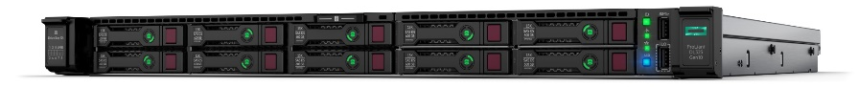
Delivering 2P Performance with 1P Economics
Avoid the 2P Tax!
The most secure & versatile 1P/1U AMD EPYC based platform
Unbeatable Value Proposition!
  Much lower cost per server vs. 2P servers
  50%VMware license cost savings
  Plus rack space and TDP savings
HPE ProLiant DL325 Gen10 Server
Up to 32 processor cores
Up to 2TBs of memory
171GB/s memory bandwidth
Up to 40TBs of NVMe storage
Silicon Root of Trust + AMD Secure Processor
Optimized for dense server virtualization and software-defined storage workloads
25% better price/performance¹!
Notes:
¹SPEC and the names SPEC CPU and SPECrate are registered trademarks of the Standard Performance Evaluation Corporation (SPEC). The stated results are published as of 06-05-18; see spec.org and http://h20195.www2.hpe.com/V2/GetDocument.aspx?docname=a00047709enw. Dell pricing from Dell site as of 05-16-18. HPE pricing is internal as of 06-05-18.
HPE is further extending the ProLiant Gen10 portfolio with the introduction of a single-socket server based on the AMD EYPC processors – the HPE ProLiant DL325 Gen10.
This platform not only provides the upmost in security, but it truly delivers 2P performance at 1P economics.
In SPEC CPU2017 Integer rate results, the ProLiant DL325 Gen10 with a single AMD EPYC processor delivers better performance at a 26% lower price than a Dell PowerEdge R440 with 2 Intel Xeon Gold processors installed for 25% better price/performance
(NOTE: the Dell PowerEdge R440 with (2) Intel Xeon Gold 5118 processors was $13,569 and the HPE ProLiant DL325 Gen10 with a single AMD EYPC 7551P was $10,789 – 26% lower price)
With today’s application and data demands, mid-market organizations have been forced into buying up to a two socket server to achieve necessary levels of performance. Single socket servers have traditionally shipped with low performance processors, limited memory and I/O.
Thanks to the AMD EPYC single socket architecture, the DL325 enables mid-market businesses to acquire enterprise class processor, memory and I/O performance and security without paying a “2P tax”.
With up to 32 cores, 2TBs of memory with 171GB/s of memory bandwidth and up to 40TBs of fast NVMe storage, the DL325 is optimized for dense server virtualization and software-defined storage workloads.
You may think what’s so new about the DL325 as Dell EMC has been in the market with the PowerEdge R6415.
First the DL325 is a more secure server than the R6415 with security rooted in silicon. The Dell server does not validate whether the server firmware is authentic by checking an immutable fingerprint in silicon.
Second, Dell did not take full advantage of the benefits offered by the AMD EPYC processor in terms of I/O. The PowerEdge R6415 offers only two PCIe slots while the ProLiant DL325 offers three PCIe slots along with support for 10 NVMe drives. While one additional slot may not seem like much, it is actually critical. We have been shipping the DL360 with 3 slots for years, and customers have repeatedly told us that having only 2 slots is insufficient.
(NOTE: 3 slots could be used for 2 NICs plus an Array Controller for data intensive applications that require high network throughput)

Slide 21
HPE SimpliVity 380
The new powerhouse in hyperconvergence

Slide 22





The evolution of hyperconvergence
Legacy Stack
Integrated Systems
Other Hyperconverged
Solutions
HPE SimpliVity
Servers & VMware
Pre-integrated storage & server
Storage Switch
Converge only
storage &
server
HA Shared Storage
Backup & Dedupe
WAN Optimization
Cloud Gateway
SSD Array
Storage Caching
Data Protection Apps
(Backup & Replication)
Notes:
Legacy stack wasn’t designed for virtualization; in 2009 VCE, etc started engineering systems for virt; Nutanix goal was to converge storage and servers into SW with cloud economics; still didn’t have backup SW- HPE SimpliVity approach to build a platform optimized from the ground up- enterprise functionality coupled with cloud agility from SW defined solution. Created HPE SimpliVity DVP
Key Points:
Integrated Systems only combines existing servers and storage under a management interface and sometimes a single support SKU for faster deployment
Other hyperconverged solutions only virtualized storage and combined it with compute on x86, scale-out resources but they did nothing “Below the line” forcing a tradeoff between “web scale” vs. enterprise capabilities
Only HPE SimpliVity infrastructure provides the industry’s most complete hyperconverged platform, delivering all IT infrastructure and data services for virtualized workloads, including built-in data protection
Script:
Let’s take a look at the evolution of convergence.
CLICK
In 2009, some of the integrated systems and reference architectures started being built. These are the VCE and FlexPods of the world. Now, they deserve a lot of credit for really kick starting this industry. But, they did nothing to fundamentally change the data architecture. What they did was basically take the top half of the legacy stack, the servers and storage, and package it.
CLICK
At around the same time, companies like Nutanix started their development. There’s some good innovation here as they took servers and storage and created a single shared resource pool, mostly for the purpose of VDI.
There are definitely some benefits, but they didn’t take it far enough. They stopped at server and storage and didn’t innovate below the line. No deduplication, compression and optimization. No global VM-centric management and mobility. No integrated data protection at the VM level.
CLICK
HPE is the only company with a hyperconverged solution that provides a single shared resource pool across the entire legacy stack; the only company that provides 40:1 data efficiency on average while increasing performance; the only company that combines all IT and data service for virtualized workloads, including built-in data protection. The only company that stands apart in hyperconverged infrastructure with HPE SimpliVity technology.
We often use this metaphor: if you’re baking a cake, you have to do everything by design, up-front. If you take the cake out of the oven, and then realize you forgot an egg, it’s too late. You physically cannot get that egg into the cake without starting from scratch. This applies perfectly to HPE SimpliVity architecture. We baked the egg in the cake, and it’s why we have deduplication, compression, and optimization for all data, inline, in real-time at inception once and forever, and others are trying to catch up.

Slide 23


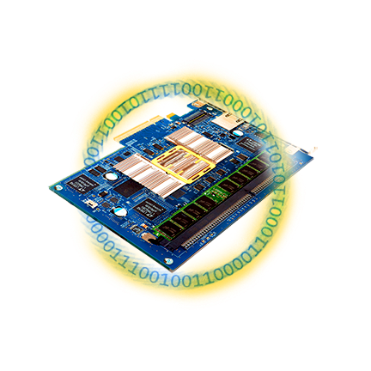




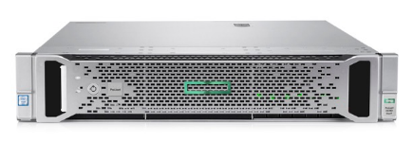
HPE SimpliVity’s Data Virtualization Platform
App 3
App 4
ESXi
PRESENTATION LAYER
HPE SimpliVity Data Virtualization Platform
DATA MANAGEMENT LAYER
X86 CPU
DRAM
SSD/
HDD
“The best IO is the one you don’t have to do.”
Notes:
Script:
Now let’s speed it up and see what happens

Slide 24
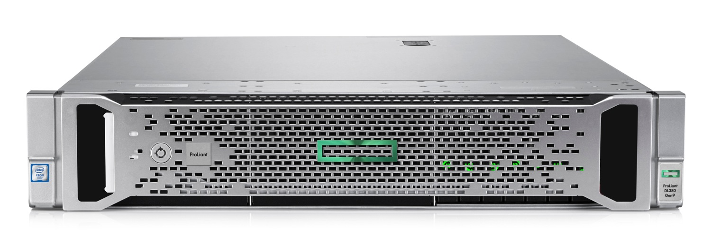


Maximize efficiency and effectiveness of existing WAN
Remote backup and replication in seconds. Enabled through globally aware deduplication.
VM1
VM1
VM2
Hypervisor
Hypervisor
Hypervisor
Hypervisor
VM 1
VM 2
VM 1
HPE SimpliVity Data Virtualization Platform
Boston
Tokyo
Notes:
To protect data across sites, HPE SimpliVity uses the Data Virtualization Platform to maintain data in a deduplicated and compressed data. We take that even further and ensure that no duplicate data will ever traverse the WAN link between sites.
[click]
Within the HPE SimpliVity Data Virtualization Platform, the Data Management layer is divided into sub-layers. The first is the File System, which keeps track and interprets the relationships between all the blocks of data. Each VM or backup is represented by a Data Container, which is a kind of recipe of how to create the VM.
[click]
The second sub-layer is the Object Store, that directly addresses the physical blocks of data. As you can see here, the Object Store only contains a single copy of each unique block.
[click]
If we want to move a VM or backup between sites...
[click]
the HPE SimpliVity Data Virtualization Platform shares the Data Container between the clusters. This gives the receiving site awareness of the blocks needed to recreate the VM or backup.
[click]
The receiving site can now identify which blocks of data are truly unique to its own Object Store, and will communicate this back to the sending site.
[click]
The sending site can now replicate over only the unique blocks (not changed blocks) over to the receiving site. Imagine that the green-blue and dark grey blocks are the core Windows files and the other blocks are business data. In this way, seeding data for the first replication can be as simple as installing a new Microsoft Windows VM in the receiving site.
HPE SimpliVity uses this same process whether a backup is being created remotely, or an entire VM is being moved.
[click]
When an entire VM is being moved, the final step is to unregister the VM in the sending site, and register it in the receiving site. Even for a large VM, this could take just a matter of minutes.

Slide 25
HPE Synergy

Slide 26
A new category of infrastructure
Composable
Simplify Infrastructure as a Service
Hardware & Software architected as one
Fluid IT
Software defined everything
Physical, virtual and containerized workloads
Hyper-converged
  Simplify deployments
  Remove complexity by
  eliminating SAN
  Fluid virtual IT
  Software defined storage
  Virtual workloads
Converged
Application optimized
  Improve staff productivity
Masks some complexity
with people and software
Preconfigured physical IT
Hardware defined
Targeted workloads
Traditional
Siloed Infrastructure
Complex processes
Static, siloed IT
Silo defined
Physical, virtual, and containerized workloads
Composability
Operations optimized
Notes:
When looking to update infrastructure, the best case scenario for customers is a single platform that can span the gambit of infrastructure needs, from traditional all the way to cloud native applications. From Mission critical to standard workloads
We’ve created the domain of composable infrastructure for this purpose

Slide 27
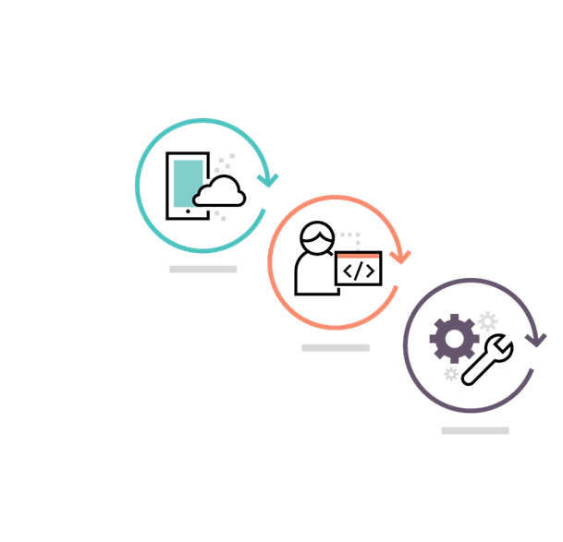





Composable Infrastructure
Architectural design principles
Unified API
  Single line of code to abstract every element of infrastructure
  Full infrastructure programmability
  Bare metal interface for Infrastructure as a Service
Composable Infrastructure
Unified API
Unified API
Fluid Resource Pools
Single infrastructure of disaggregated resource pools
Physical, virtual, and containers
Auto-integrating of resource capacity
Software Defined Intelligence
Software-Defined Intelligence
Fluid Resource Pools
Software-Defined Intelligence
Template-driven workload composition
Frictionless operations
Fluid Resource Pools
Notes:
Fluid Resource Pools
A single infrastructure with fluid pools of compute, storage, and fabric, so all the resources are now always available and can be instantly configured according to the specific needs of each application, reducing the need for costly infrastructure silos.
Single infrastructure of disaggregated pools of compute, storage and fabric that boots-up ready for any workload
Physical, virtual and containers
Auto-integrating of resource capacity
Software-Defined Intelligence
Internal software-defined intelligence with template driven, frictionless operations abstracts away the need for IT admins to understand operational minutiae of various hardware components replacing it with high-level, automated operations.
Template-driven workload composition
Frictionless operations
Unified API
The Unified API increases productivity and control across the data center by integrating and automating infrastructure operations and applications, eliminating time-consuming scripting of multiple varied low-level tools and interfaces.
Single line of code to abstract every element of infrastructure
Full infrastructure programmability
Bare metal interface for Infrastructure as a Service

Slide 28

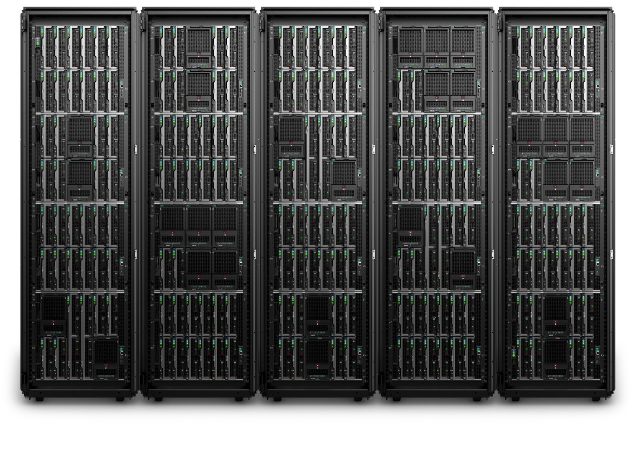
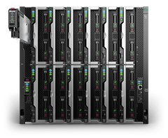


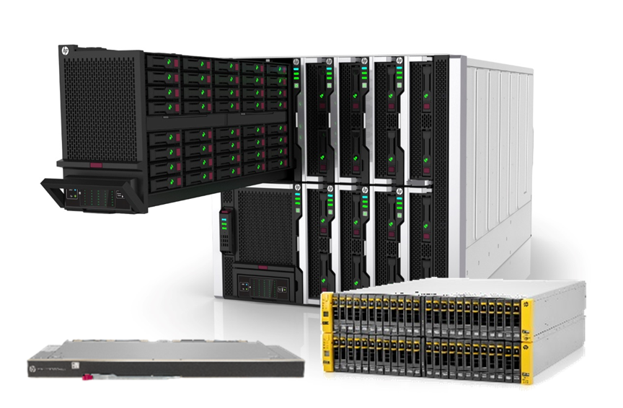
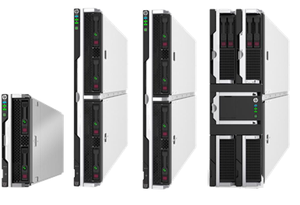
HPE Synergy Updates
  Composable Frame
  Everything needed to run applications, so IT can be quickly setup and consumed
  Auto-integrating makes scaling simple and automated at rack/row scale
Composer
Integrated software-defined intelligence to self-discover, auto-integrate, provision and scale from racks to rows
Composable Fabric
Rack scale multi-fabric connectivity eliminates standalone TOR switches
Composable Compute
Provides the performance, scalability, density optimization, storage simplicity, and configuration flexibility
Composable Storage
High-density integrated storage to compose any compute with any storage (SDS, DAS, SAN)
HPE Synergy: Powering your Hybrid cloud transformation

Slide 29

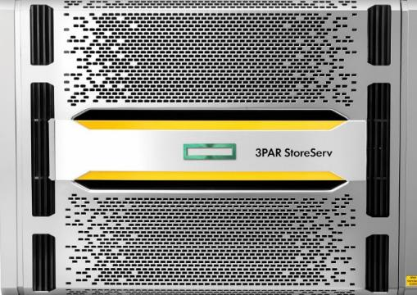
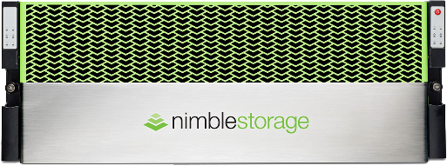
CLOUD
READY
CLOUD
READY
Cloud-ready storage provides agility and data mobility between on-prem devices and to the public cloud
Notes:
HPE’s flash storage portfolio was architected for agility with federated data mobility across all-flash and hybrid systems, across primary and secondary storage, and even from on-premises to the public cloud. This extreme flexibility means you can deploy flash everywhere and assign applications to the best type of storage for a given price-performance requirement but easily and non-disruptively adjust as needs change. This includes the ability to host primary volumes and archive tiers in Azure and AWS so that your on-prem storage deployments are cloud-ready from day 1.

Slide 30
HPE 3PAR: The broadest flash array family in the industry
Affordable
Lightning Fast
Enterprise-Class
75%
$1.20/GB
3.8 million IOPS 20840/20850
24PB
99.9999%
Data Reduction
Guaranteed
Usable
1.8 million IOPS 9450
Scale
Availability
1 million IOPS 8440/8450
ONE OS. ONE Interface. ONE Feature Set. ANY Workload. FEDERATED Mobility.
Notes:
One of the nice things is the very same 3PAR OS providing the same features, management experience and integrations across all models from the 2-node 8200 up to the 8-node 208xx systems.
Just chose the model that fits your requirements for space, performance, headroom and cost.
V26: added speakers notes
V20: updated the 9450 IOPS numbers
V17: added the 9450; updated 20k max IOPS; new pictures
V14: changed performance column and pictures
V11: new slide

Slide 31

Eliminating distinctions between Midrange and Tier 1
Storage without Boundaries
20800
20840
20850
2 – 8 Nodes
ONE Architecture from Midrange to High-end
Midrange – Flash – High-end
Common Tier-1 Feature Set
Interoperability end-to-end
Only HPE
9450
20450
2 – 4 Nodes
8400
8440
8450
2 – 4 Nodes
8200
2 Nodes
Same 3PAR OS
When Performance matters
20840/50 – 3.8 million IOPS @ <1 ms latency
20450 – 1.8 million IOPS @ <1 ms latency
9450 – 1.8 million IOPS @ <1 ms latency
8450 – 1 million IOPS @ <1 ms latency
When Scale matters
20800/40 – up to 9.6 PiB raw capacity
8440 – up to 4 PiB raw capacity
When Value matters
8200 AFA starting at $19k
Notes:
One of the nice things is the very same 3PAR OS providing the same features, management experience and integrations across all models from the 2-node 8200 up to the 8-node 208xx systems.
Just chose the model that fits your requirements for space, performance, headroom and cost.
V26: added speakers notes
V23: updated text
V21: updated
V20: updated the 9450 IOPS numbers
V19: reduced the number of systems to make the slide less busy
added the 9450; updated 20k max IOPS; new 20k pictures
V14: new graphics
V08: added the 20840
V03: update entry price for 8200 AFA
V01: new portfolio consisting of the midrange StoreServ 8000 and the high-end StoreServ 20000 systems

Slide 32
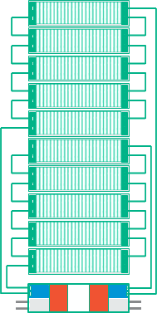
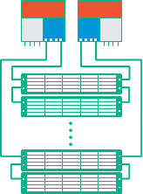

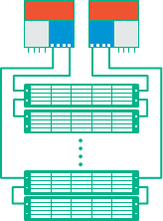
3PAR Hardware Architecture
Cost-effective, scalable, resilient, meshed, active-active
8200
with 2 nodes
84x0
with 2 nodes
84x0
with 4 nodes
9k or 20k
with 2 nodes
9k or 20k
with 4 nodes
20k
with 8 nodes
Mesh Active-Active Cluster
Delivering sustainable performance even with high levels of capacity utilization
System Wide Striping
Massively parallel & fine-grained striping of data across all internal resources assures high & predictable service levels
Any volume exists behind
every Drive
every Node
every Port
Host Ports
Cache
Disk Ports
Notes:
The 3PAR hardware architecture is based on node-pairs owing a set of drives.
Node pairs can be clustered to build active-active 4-, 6-, 8-node configuration with shared cache.
The 84x0 and 20450 systems can be installed with 2 or 4 nodes initially, the 208x0 with 2, 4, 6 or 8 nodes.
The systems can be upgraded online to their max node count.
V26: added speakers notes
V22: reworked the slide and added text
V17: added the 9000
V06: updated drawing colors to HPE green
V02: changed 7000 to 8000

Slide 33
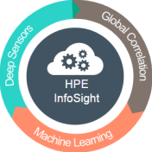

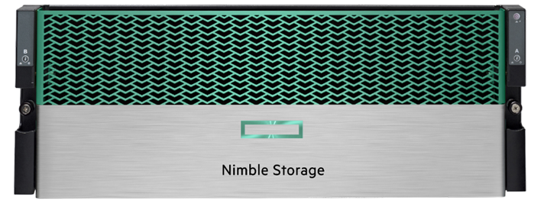
HPE Nimble Storage Portfolio Overview
Performance
(IOPS)
Capacity
(Effective TBs)
All Flash Arrays
AF series
Hybrid Flash Arrays
HF series
Storage Tier
Primary storage
Secondary storage
Usage / Workloads
High performance primary applications
Other primary applications
Veeam, DR, dev/test,
other secondary apps

Slide 34
All Flash Arrays – For High-Performance Primary Workloads
Sheer Performance and Scalability
  Scale-up and scale-out
  Always on data services
  Quality of service
33%-66% less TCO
  20% more usable capacity
  Backup/DR at a third of the cost
Absolute Resiliency
  Guaranteed six-nines availability
Notes:
We offer All Flash and Adaptive Flash (hybrid). This slide refers to our AFA, which was built to be generationally beyond other all-flash arrays:
Sheer performance and scalability
A TCO that’s 33% to 66% less than other All Flash arrays. This is due to fundamental architectural advantages.
Absolute resiliency – a key requirement for every enterprise

Slide 35
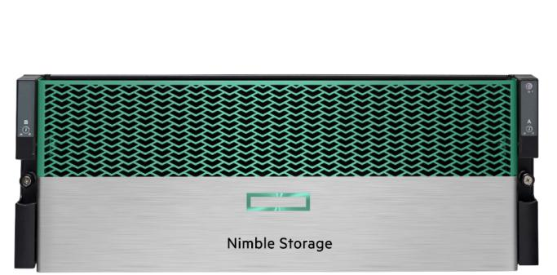
All Flash Array Family
AF80
Up to 4PB eff. Capacity
390k IOPS
AF60
Up to 2PB eff. Capacity
240k IOPS
AF40
IOPS
Up to 682TB eff. Capacity
125k IOPS
AF20
Up to 168TB eff. Capacity
22.5k IOPS
AF20Q
Up to 128TB eff. Capacity
22.5k IOPS
Effective capacity based on a 5X data reduction from compression and dedupe on a single node
Performance based on random mixed 50/50 R/W on 4KB blocks, 2X dedupe
Performance numbers will continue to be tuned beyond launch
Notes:
Nimble Storage’s All-Flash Platform is engineered to meet the needs of the Enterprise market space as well as the needs of the SMB. Each consecutive member of the All-Flash Platform bring with it more performance and storage capacity.

Slide 36
Nimble All-Flash Storage specs
AF-Series Arrays | AF20Q | AF20 | AF40 | AF60 | AF80
Raw capacity (TB/TiB) | 6–46 / 5-42 | 6–46 / 5-42 | 11-184 / 10-167 | 11–553/10-502 | 23–1106/21-1005
Usable capacity (TB/TiB) | 3-25 / 2–23 | 4–33 / 3–30 | 8–136 / 7–124 | 8–407/7–370 | 17–815/15–741
Effective capacity (TB/TiB) ³ | 14–128 / 13–116 | 18–168 / 16–153 | 40–682 / 36–620 | 40–2037/36–1853 | 82–4075/75–3706
Max. # of expansion shelves | 1 | 1 | 1 | 2 | 2
RAID level | Triple+ Parity
Onboard 1 Gb/10 Gb ports per array ^{2, 4} | 4 | 4 | 4 | 4 | 4
Optional iSCSI 1 Gb ports per array | 0 – 16 | 0 – 16 | 0 – 24 | 0 – 24 | 0 – 24
Optional iSCSI 10 Gb ports per array | 0 – 16 | 0 – 16 | 0 – 24 | 0 – 24 | 0 – 24
Optional FC ports per array | 0 – 16 | 0 – 16 | 0 – 24 | 0 – 24 | 0 – 24
Max. power (watts / kVA) | 600 / 0.667 | 650 / 0.722 | 800 / 0.889 | 850 / 0.944 | 1200 / 1.333
Thermal (BTU) | 1968 | 2132 | 2624 | 2788 | 3936
² for iSCSI and/or Mgmt.
³ Effective capacity is the capacity of the base array and maximum number of expansion shelves. Assumes data reduction of 5:1 from deduplication and compression.
⁴ Onboard ports are 10GbaseT. Optional ports are: 1GbaseT, 10GbaseT, or 10GbE SFP+

Slide 37
Adaptive Flash Array Family
HF60
Up to 5PB eff. Capacity
220k IOPS
HF40
Up to 2PB eff. Capacity
110k IOPS
HF20C
IOPS
HF20
Up to 2PB eff. Capacity
22.5k IOPS
HF20H
Up to 845TB eff. Capacity
22.5k IOPS
Up to 821TB eff. Capacity
22.5k IOPS
Effective capacity based on a 5X data reduction from compression and dedupe on a single node
Performance based on random mixed 50/50 R/W on 4KB blocks, 2X dedupe
Performance numbers will continue to be tuned beyond launch
Notes:
Nimble Storage’s Adaptive-Flash Platform is engineered to meet the needs of the SMB and smaller Enterprise customers. Each consecutive member of the CS-Series family provides more performance along with a large effective capacity.

Slide 38
Nimble Adaptive Flash Storage specs
HF-Series Arrays ¹ | HF20 | HF20H | HF20C | HF40 | HF60
Raw capacity (TB / TiB) ⁴ | 21-210 / 19-191 | 11-211 / 10-192 | 21-1260 / 19-1146 | 21-504 / 19-458 | 21-1260 / 19-1146
Effective capacity (TB / TiB) ⁴ | 16-169 / 14-153 | 7-164 / 6-149 | 16-1016 / 14-924 | 16-406 / 14-369 | 16-1016 / 14-924
Data Reduction ⁵ | 81-845 / 74-768 | 34-821 / 31-746 | 32-2032 / 29-1848 | 81-2030 / 74-1846 | 81-5080 / 74-4621
Max. # of expansion shelves | 6 | 6 | 6 | 6 | 6
Flash capacity (TB/TiB) ⁴ | 23/21 | 15/13 | 23/21 | 23/21 | 23/21
RAID level | Triple+ Parity
Onboard 1 Gb/10 Gb ports per array ^{2, 3} | 4 | 4 | 4 | 4 | 4
Optional iSCSI 1 Gb ports per array | 0 – 16 | 0 – 16 | 0 – 16 | 0 – 24 | 0 – 24
Optional iSCSI 10 Gb ports per array | 0 – 16 | 0 – 16 | 0 – 16 | 0 – 24 | 0 – 24
Optional FC ports per array | 0 – 16 | 0 – 16 | 0 – 16 | 0 – 24 | 0 – 24
Max. power (watts / kVA) | 750 / 0.833 | 650 / 0.722 | 750 / 0.833 | 850 / 0.944 | 900 / 1.000
Thermal (BTU) | 2460 | 2132 | 2460 | 2788 | 2952
¹ HF20 and HF40 support scale up to any model within the HF family. HF20H supports scale up to the HF40 Adaptive Flash array.
² for iSCSI and/or Mgmt.
³ Onboard ports are 10GbaseT. Optional ports are: 1GbaseT, 10GbaseT, or 10GbE SFP+
⁴ Raw, usable, and effective capacities are shown in TB (10^12 bytes) and TiB (2^40 bytes). Usable and effective capacities take into account space used for parity, spares, SSD cache, and system overhead.
⁵ Deduplication currently supported on HF20H, HF20, HF40, and HF60; the HF20C does not support dedupe and is capacity optimized to scale to over 1PB.

Slide 39

NimbleOS – Filesystem Optimized for All-Flash and Adaptive-Flash
Adaptive Flash (Hybrid) Arrays
All-Flash Arrays
Writes
Reads
Writes
Reads
NVDIMM
write cache
NVDIMM
write cache
Variable
Block Inline
Dedupe
Variable
Block Inline
Dedupe
Variable
Block Inline
Compression
Seq Layout on Flash
(Read cache)
Variable
Block Inline
Compression
Sequential layout on disk
Sequential layout on flash

Slide 40
Tenable Security Solutions

Slide 41



Tenable SC and .IO Detail
Vulnerability Management
  Enterprise management
  Live asset discovery
  Reporting
  Integrations & API
  Agents
  Passive monitoring
On-prem vulnerability management for compliance monitoring
Cloud-based Cyber Exposure platform for modern assets – from IT to cloud to IoT and OT
Powered by on-prem Nessus Scanners, Agents, & Network Monitor
Vulnerability Assessment
  Comprehensive
  High Performance Scanning
  Extensize Configurabiltiy
Notes:
Insert slides after this one that shows your product details. We will NOT go over every slide, so it is OK to have a lot of slides in here. Think of this as a place a Dasher sales or SE can go to in order to get slides some evening before they have a meeting the next day.
We will HIDE slides we do not plan to present during the training.

Slide 42
Nessus
An Active Scanner
Enter an IP Range and it will scan for vulnerabilities
SW Licensed as a VM Software (or on client hardware)
Supports: Windows, Linux, MAC, AWS
Filter by Host or by IP
Used to Perform Audits
Iterative process of running scans, fixing & addressing vulnerabilities and then running scans again

Slide 43
Security Center
Two solutions in the SC portfolio
  Security Center – Traditional
    Ongoing Vulnerability Management
    Active Scanning only (Not passive like Continuous View)
    Not Collecting Logs
    Scan once per month / once a day, etc., dump to a database
    Point in time scanning
    Manage unlimited Nessus Scanners
  Security Center – Continuous View
    Continuous Monitoring
    Adds Passive capability, via Nessus Network monitor (via tap port monitoring)
    Ingest real-time logs and move clients toward real-time monitoring
    1Gig version is sold as a VM (Flavor of Linux)
    10Gig version is sold as an appliance
    Licensed based on the number of Assets you are looking to manage
    Compliance monitoring – Trending and Reporting is a key buying decision
      If clients looking for NIST or PCI or HIPPA or ... Compliance SCCV will help them stay compliant

Slide 44


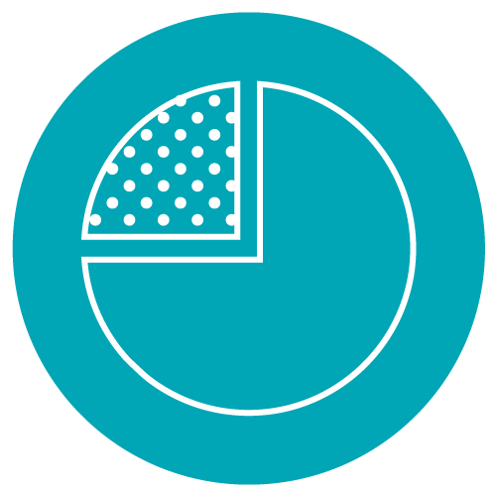

Key Capabilities: Nessus Professional
Supports the
widest range of technologies,
with accurate,
high speed
asset discovery
Provides one of the largest databases of compliance and configuration audits for a wide variety
of systems
Delivers un-credentialed vulnerability discovery and credentialed scanning for system hardening and missing patches
Provides multiple options for viewing and filtering scan results, as well as generating reports
Notes:
One stat to share about coverage when talking about these key features:
•Through Nessus audits and supported assets, Tenable covers nearly 30% more CVEs (Common Vulnerabilities and Exposures) and 30% more technologies than competitive solutions.

Slide 45








Assets and vulnerabilities are changing
web app
public cloud
server
desktop
laptop
mobile
virtual
container
Notes:
The first challenge I mentioned earlier is the changing nature of assets and vulnerabilities.
Years ago, there simply weren’t as many types of assets. There were servers, desktops, network devices, laptops.
In the old days, 1 IP address usually equaled 1 Asset.
But as organizations have increased their use of cloud, mobile, and DevOps, the fundamental concept of an asset has changed.
Some resources – like laptops, mobile devices, and virtual machines – may have *many* IP addresses.
At the same time, other resources – like web apps and Docker containers – may not even have IP addresses.
The changing nature and ownership of assets impact how security teams do their jobs and even how they interact with their peers.

Slide 46
Resources
Where can I learn more about Nessus?
https://www.tenable.com/products/nessus/nessus-professional
Who uses Nessus?
https://www.tenable.com/customers?keys=&field_collateral_topic_tid=All&field_collateral_products_tid=80
How easy is it to use Nessus?
https://www.tenable.com/education/on-demand-courses
Notes:
These are some of the common questions we get about Nessus – as well as asking if a free trial is available. So here are a few useful resources. And while you’re on the Tenable site, you can request a free trial of any Nessus product to check it out for yourself.

Slide 47
We Take IT Personally
Notes:
To add slide numbers: Go to Insert→ Header & Footer → Check Slide Number Box → Apply to All

