Slide 1
Assessing Data Quality for Healthcare Analytics:
A Tiered Approach to Secondary Use of EHR Data
Brian Paciotti, PhD, MS
Douglas Berman, SM
UC Davis Health – IT Health Informatics
Healthcare Informatics
Notes:
Our abstract:
As the use and availability of Electronic Health Record system have expanded so have opportunities to reuse the information they collect to improve clinical outcomes, reduce costs, improve health system operations and support a variety of research activities.
Although the opportunities for secondary reuse of EHR are immense, many questions quickly emerge concerning the quality of the data. There is often a mismatch between the data quality required when originally collecting data and the data quality needed later after data has been collected when critical analytic questions arise.
Some specific factors are identified; First, heterogeneous, complex and dynamic clinical workflows often create complex and messy data. Second, EHR systems are complex dynamic systems that evolve through time, thus the data often change through time. Third, concepts that analysts want to represent in their models are often represented by in numerous and incomplete database fields. Finally, these and other data issues are often undocumented—it is only by laborious analytical work and clinical ethnography that analysts can obtain the highest quality of data.
Many analytical teams are not fully aware of the challenges associated with identifying and repairing data quality issues. To achieve better project outcomes, we discuss a framework to categorize projects into data quality tiers as well as a process for validating data for re-use.

Slide 2
Some materials for this presentation originated in
UC Davis Extension:
Health Information Literacy for Data Analytics Specialization
  Four courses
    Healthcare Data Literacy
    Healthcare Data Models
    Healthcare Data Quality and Governance
    Analytic Solutions to Common Healthcare Problems
  On Coursera at: https://www.coursera.org/specializations/healthcare-information-literacy-data-analytics

Slide 3
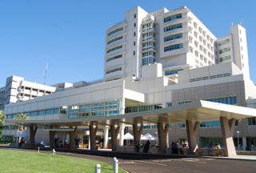
About UC Davis Health
Based in Sacramento, California, a nationally renowned academic medical center where clinical practice, teaching and research converge to advance human health.
  625-bed multispecialty academic medical center
  Serves 33 counties covering a 65,000-square-mile area north to the Oregon border and east to Nevada
  Recognized as one of the “Most Wired” hospitals in the U.S.
  UC Davis Medical Center is one of the top five hospitals in California, as ranked by U.S. News & World Report.
  UC Davis Medical Center was granted Magnet® recognition by the American Nurses Credentialing Center (ANCC), considered the nation’s highest form of recognition for nursing excellence.

Slide 4
Today
We will discuss:
  EHR’s and secondary use of healthcare data
  The source of the complexities we encounter when we use it
  How complexity impacts user’s ability to create value from the data
  How we are managing that complexity in focused ways
  How we work with our community to create awareness, understand, and overcome the challenge

Slide 5
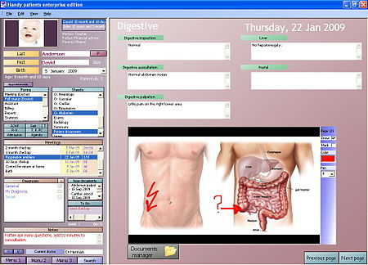
EHR Data – Review
EHR system main purposes:
  Care of patients
  Management of the clinic
  Support for billing
  Communication among providers
  Some research - functions are maturing
EHR unifies data from many clinical environments including physician's offices, hospitals, ICU settings in a hospital, the operating room, recovery rooms, home health, and the emergency department.
Some data are structured, but the much of the data is stored within provider notes
The EHR structures the data collection process within the workflow

Slide 6

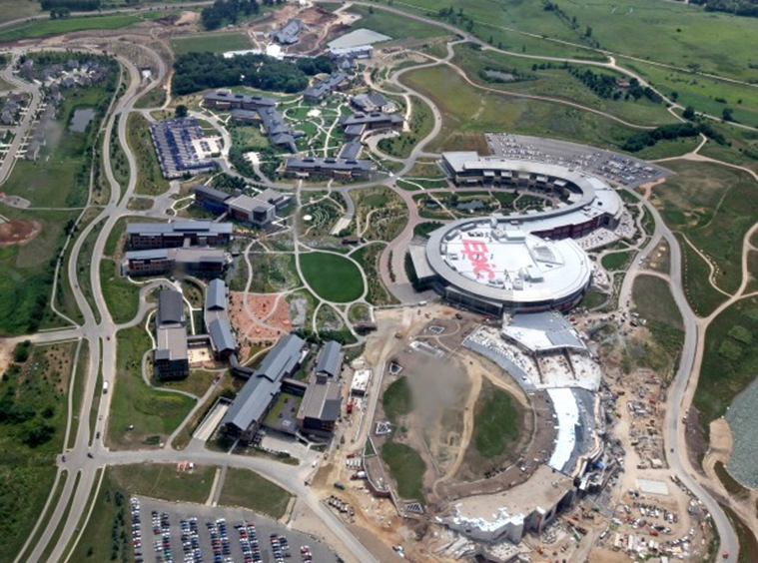



EPIC
Founded in a basement in 1979 with 1½ employees
Holds 28 percent of the U.S. acute care hospital market share
All UC Medical Campuses are clients.
More than 250 million patients have a current electronic record in
40% of operating expenses invested in R&D
http://www.epic.com/about

Slide 7
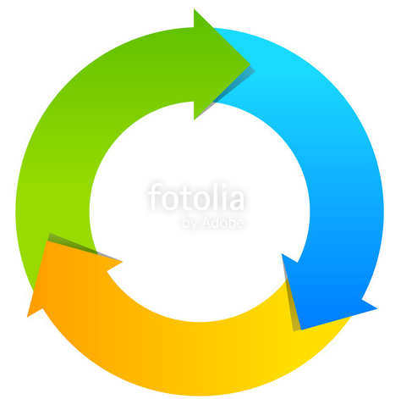
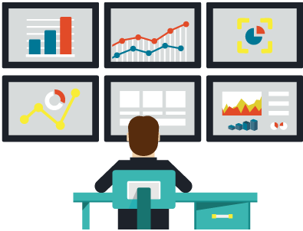
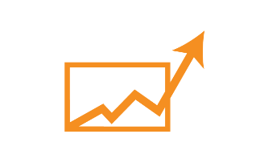
The Learning Health System
Learning Health Systems (AHRQ)
Gather and apply information in real-time
Leverage technology to share new evidence
Capture and analyze data to improve care
Create a feedback cycle for learning and improvement
Practice
Data
Data-Driven
Improvement
Knowledge

Slide 8
Secondary use of data is a part of this model.
Examples of secondary uses of EHR data:
Improve Clinical patient Outcomes
Reduce Health System Costs
Improve Health System Operations
Regulatory reporting
Support for population health
Identification of Best Practices
Development of predictive algorithms
Development of AI models
Identification and recruitment of possible clinical trials participants

Slide 9
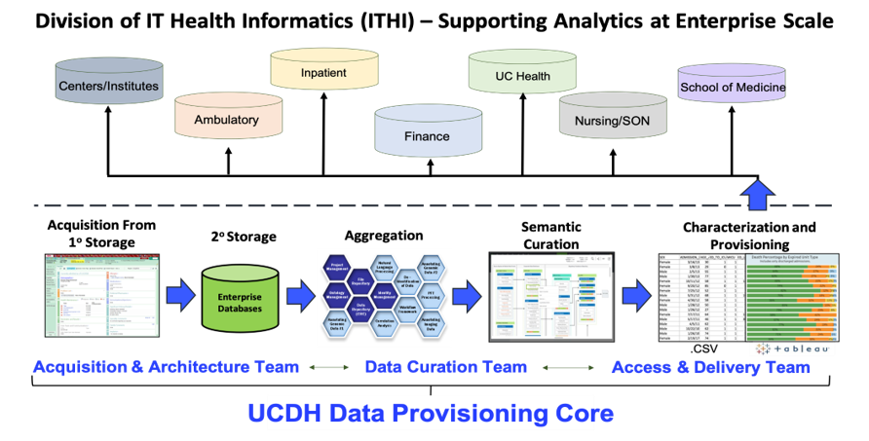
Data Provisioning Core

Slide 10
For More on UCDH Health Data Provisioning Core and how it supports the learning health system
Enterprise Health Data Provisioning
  Kent Anderson, Dr Jason Adams
  Tomorrow (Wednesday) 2:00 – 2:45

Slide 11


Partnership for Data Curation
Data
Validation
Validation
Knowledge
Knowledge
Data Literate Clinician
Clinically Literate Technologist
Inference
Meaning
Discovery

Slide 12
We aim to validate data that supports our analyses
Through curation we ensure the data we deliver for a particular analysis consistently:
  Supports appropriate inferences over time
  Supports appropriate inferences across patients
  Supports appropriate inferences across care environments (clinics, wards, hospitals, health systems)
  Supports appropriate inferences across providers
  Data can be validated for specific analyses

Slide 13
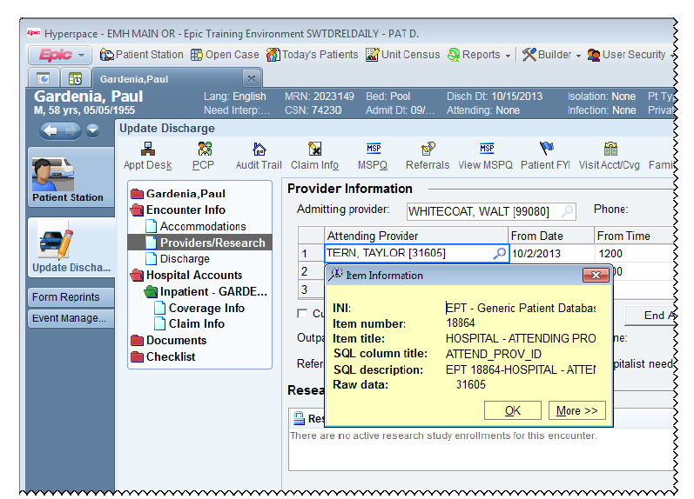
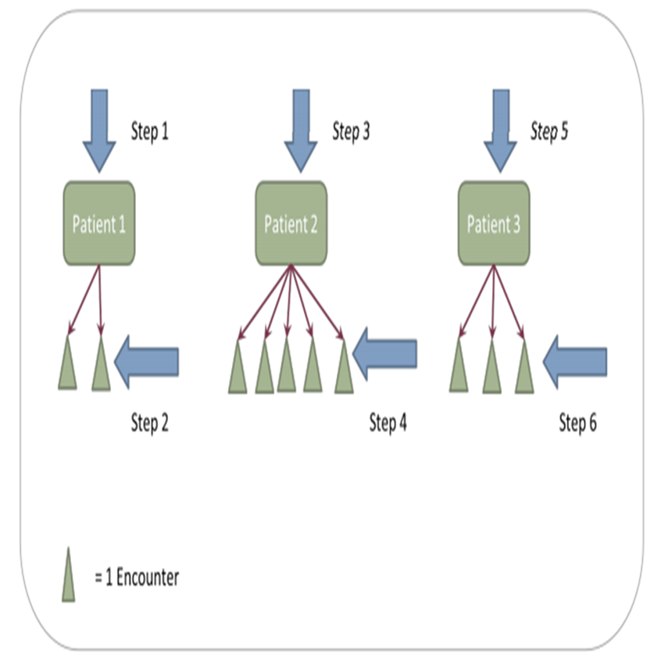
How Clinical Data are Stored
Data in Epic is stored in a hierarchical database called Chronicles
  The hierarchy is appropriate operationally
    It maintains each datum collected with related data in context of the clinical workflows.
    It quickly stores and retrieves information as it is accessed in a clinical environment
  Hierarchical databases are problematic for analyses
    It is very slow to search encounters for large number of patients
    Tools for working with Hierarchical databases are limited

Slide 14
Epic’s solution: a Normalized Relational Database
Designed to facilitate reporting and analytics for populations, clinic and financial reporting
  Supported by many standard tools
  Enables quick retrieval, summarization and comparison of events across encounters, patients, providers, hospitals, etc
  Removed from its context in the hierarchy we must be cautious that we are summarizing or comparing comparable things.

Slide 15
Context: Asking Questions about Data Origins
When data is removed from the its original context we need to ask questions like:
What does the data entry form indicate the data means?
Considering the clinician, the nurse, the practitioner, who is entering the information at the point of care into the electronic health record?
What did that person have in mind when they stored this information?
Is it consistent across data entry personnel? Is it consistent across units, departments, organizations? We need to consider these contextual questions to effectively aggregate data and transform it from raw data into information.
What was the context of any transformation that may have occurred to this data?
Did it arrive in the electronic health record fully complete, well understood, documented, and a data dictionary existed to transform this information. Or did somebody need to spend some time transforming this information?
Could a system have transformed this information into some other format? What is the context of any interpretation that might have occurred to this data? Assuming the data was created in an electronic format, did it stay that way throughout the course of acquisition into storage aggregation and analysis, or did some inferences need to be imposed on this information to retain the understanding of the data we have?

Slide 16
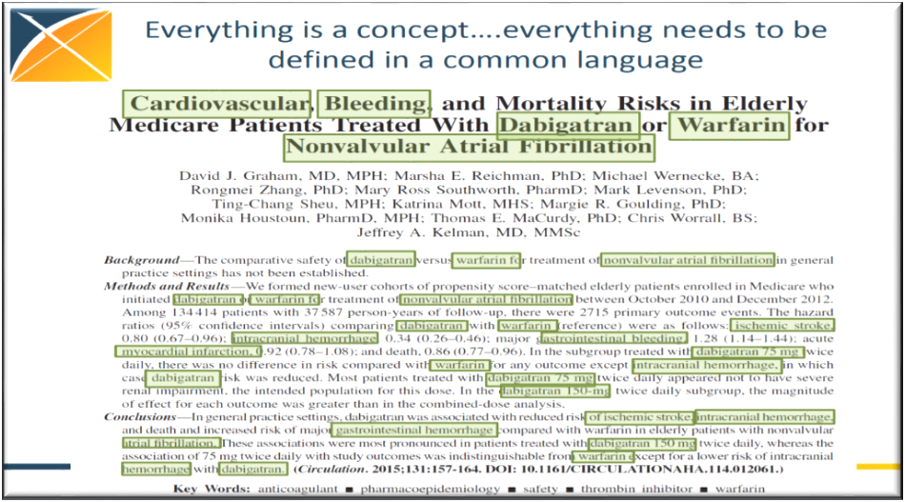
Everything is Concept – Analytics Moves Data to Conceptual Representation
Ontologies (theories) that describe problems and solutions are based on defined concepts and their relationship
All analytical projects start with concepts!
Analytic projects seek data to represent concepts. But EHR data in itself is often extremely variable over time, across medical specialties, clinicians, etc.

Slide 17
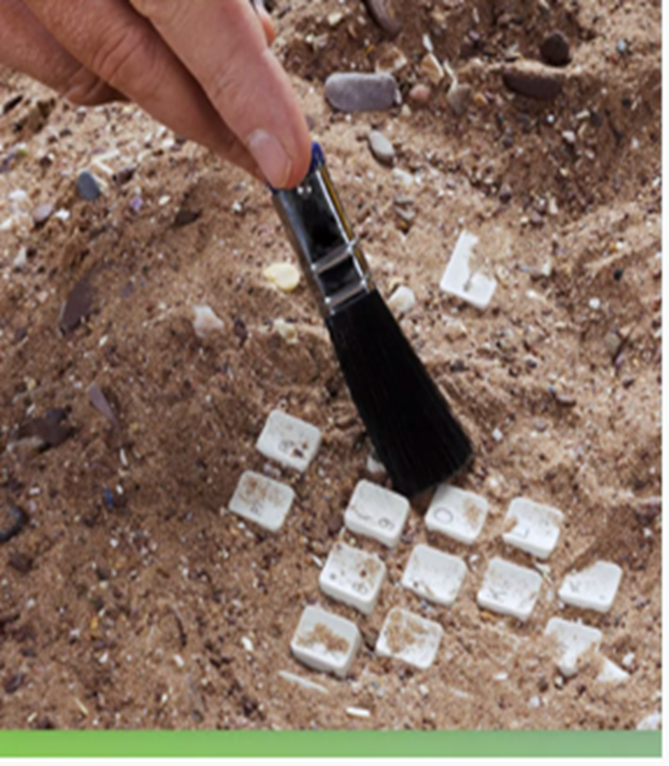
In Healthcare Complex Workflows, ETL = Data Complexity
Healthcare data from an electronic health record system requires the need to carefully understand who entered the data and for what exact purpose
This becomes especially important when data are used for a different purpose – EMR data is generally collected for documenting patient medical issues and associated care that is provided.
  If it is used for research at a later time – secondary use – the researchers has to be very careful.
Data science is an archeological process— We bring meaning and information from data, this only happens by understand the history and evolution of the data.

Slide 18

EHR Data: Complex Processes and Variable Quality

Slide 19
What Causes Data Quality Issues?
Data quality (DQ) is a complex multi-dimensional topic
Before providing an ontology of DQ—it is helpful to consider what types of processes lead to variable or low data quality
Data Origins—Process of Collection Leads to Heterogeneity, Errors, etc.
  As discussed above, EHRs have complex workflows that evolve through time
  Hence, data become complex and potentially error prone
ETL Errors—Moving data between databases and structures can alter data
  Thus, the curation process can alter data in negative way

Slide 20
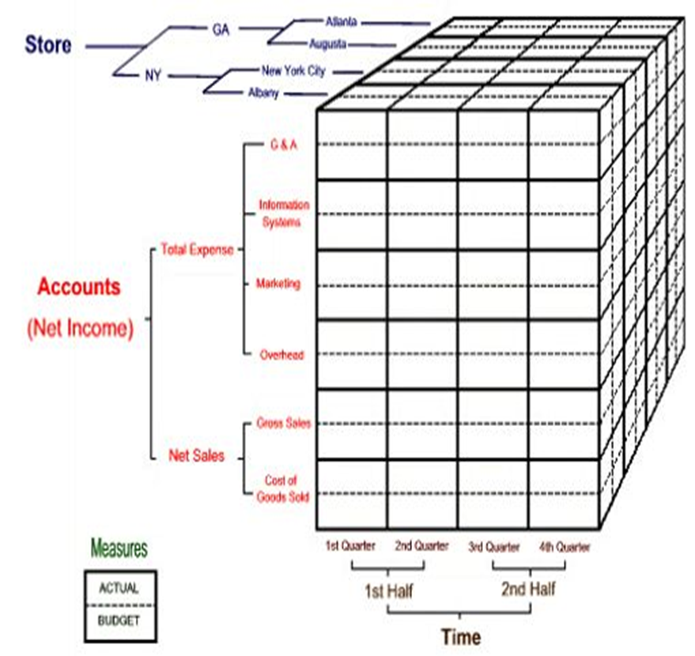
Characterize / Profile Data: Give Domain Experts Opportunity to Understand Data
Data Characterization/Profiling—communicate what data are available
  Analytical output may not be meaningful on its own—humans apply domain knowledge when looking at counts, distributions, etc.
    “I expected to see a higher percentage of “ethnic group A”
    “I think we have more cancer patients than these numbers suggest for this year”
    “Wow, this is exciting, I see a lot of patients with disease x and procedure y – I can use this cohort for my research”
How can users obtain more information about the data?
  Provide access to data characterization reports
What strategies can we employ to provide users access?
  Cubes to pre-aggregate important dimensions (strata)
  Tableau dashboards to visualization dimensions (strata)

Slide 21
Data Quality Terminology – What Tests/Metrics Can Help?
Michael Kahn (University of Colorado) has good data quality ontology
Two assessment contexts: Verification and Validation
  Verification: metadata constraints, system assumptions, and local knowledge
  Validation: alignment of data values with respect to relevant external benchmarks
Three DQ categories: Conformance, Completeness and Plausibility
Conformance and Plausibility categories are divided into subcategories

Slide 22
Standardize Using Data Quality Terminology – Help Teams Communicate/Understand
Notes:
Verification
Conformance : value – gender has one of the following concept ids: 8507 (male), 8532 (female) or 8551 (unknown).
Conformance : relational – gender concept ids will reflect only these values and be represented in the CodeMapping table.
Conformance : computational – code review to determine proper count logic
Completeness – gender can not be null nor any other value
Plausibility : uniqueness – patient MRNs and associated genders should be unique
Plausibility : atemporal – counts of patients based on gender reflect those found in Caboodle and Clarity; distribution of male/female is correct
Plausibility : temporal – counts and distributions, between ETL loads, are similar
Validation
Conformance : value – gender concept ids in use correspond to those found in the concept table; i.e. mapping between source component ids to standard concept ids are correct
Conformance : relational – values conform to other UCHDW participants
Conformance : computational – none?
Completeness – count of null/other values are similar to other UCHDW participants
Plausibility : uniqueness – none?
Plausibility : atemporal – distribution of male/female is similar to other UCHDW participants
Plausibility : temporal – none?

Slide 23
Unrepresented Data Quality Elements
DQ issues related to operational features such as:
  Data Access
  Availability
  Security
  Maintainability
Fitness-for-use features such as:
  Timeliness
  Appropriate amount for intended use
  Relevancy
  Structure of data file
Trusted – buyoff from end users that data is trustworthy
Cause - identify and track root causes of wrong values

Slide 24
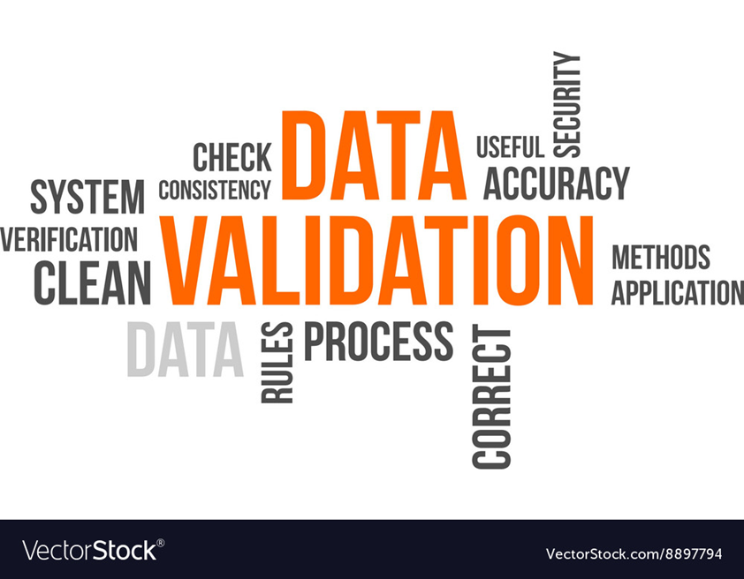
Data Curation and Validation

Slide 25
Definitions: Curation and Validation
Curation is the process of developing, describing, and documenting algorithms—either simple or complex—which transform data into useful concepts.
Validation is confirmation that the algorithm (regardless of complexity) is doing what it's intended to do.
  Highest validation level means you’re sure that the algorithm will work for a larger population than the one you validated (generalizability).
These two factors are collinear, in that the more complex your algorithm, it's implied that you've validated it through the lower levels repeatedly in order to find the exceptions, etc. that need to be accommodated by the algorithm. Your "confidence" in the algorithm is high by virtue of the fact that you've looked at the data more.

Slide 26

ETL Processes – Curating Data for Analytical Output
EHR data stored in complex data structures. Curation requires a number of ETL processes
Extraction
  Identify which database fields match specific concepts
Transform
  Transform the data make it conform to the concepts required by knowledge model
  Aggregate, transpose, recode, modify, etc
Load
  Put data into new database or new database structure
  Provide documentation and metadata to show extraction and transformation processes

Slide 27
Data Validation Initiatives
ETL Validation
  Represent data in target database as it is represented in the source databases (e.g., compare counts between Clarity/Caboodle and OMOP CDM)
  CDM Conformance. Do our Tables, Fields, and Values conform to constraints imposed by data model and data coding standards?
Data Origin Validation (Content Validation)
  Identify data issues that might be present in the source data as a result of how data were input/collected

Slide 28

Communication: Identify Required Level of Quality/Curation/Validation

Slide 29
A practical definition of Data Quality
Within the scope of a particular question/use of data we can define data quality:
    A dataset has sufficient data quality for a particular use when it can be demonstrated sufficiently robust to answer that question.
For communication and training data users, we summarize this principle into a tiered model

Slide 30
Data Quality based on typical validation Methods
All data has been transformed
Algorithms to check consistency have identified outlying or other unusual observations
Tier III – Clinically Targeted Samples which minimize systematic bias
Tier IV – Formally Validated and Generalizable
Research / Regulatory
Thorough and exhaustive manual review of each data element over time
Tier II – Algorithmically Validated
A statistically significant sample of observations have been reviewed to ensure they are accurate
Tier 0
Raw Data
Data collected and reported as captured by native data system
No post-collection processing, filtering, categorization or validation
Collection system internal checks only. i.e. ranges, data types and validation at entry
Tier I –
Minimal aggregation and high-level validation
Expert review of aggregate data is consistent with expectations
Observations are targeted to particularly sensitive areas of concern

Slide 31
Data Quality based on data use case
Tier I –
Minimal aggregation and high-level validation
Reporting basic trends
Exploring operations
Scheduling, planning, summary level reporting
Accurate portrayal of work flows
Tier III –
Registry/Clinical Decision-making
Must accurately identify patients, their health status and other key information
Level IV –
Research / Regulatory
Can withstand peer review
Publishable quality
Low-risk decisions
Tier II –
Operational / Financial Planning
Data used in clinical decision making for care of individual patients
Well understood / unambiguous data sources
Accurately identifying populations for care for participation in programs of care
Tier 0
Raw Data
Real-time operational uses – Data remains in the context where it is collected

Slide 32
Questions

Slide 33
Thank you -
For More on UC Davis Health Data Provisioning Core and how it supports the learning health system go to :
  Enterprise Health Data Provisioning Session
    Kent Anderson, Jason Adam
    Tomorrow 2:00 – 2:45
UC Davis Extension: Health Information Literacy for Data Analytics Specialization
  On Coursera
  Four courses
    Healthcare Data Literacy
    Healthcare Data Models
    Healthcare Data Quality and Governance
    Analytic Solutions to Common Healthcare Problems
  https://www.coursera.org/specializations/healthcare-information-literacy-data-analytics

