Slide 1
THE POWER OF CAMPUS COLLABORATION
BUILDING AN INTEREST GROUP
TO CREATE POSITIVE OUTCOMES
UC DAVIS/ UC DAVIS HEALTH CENTER GEIT GROUP
Notes:
How many attended WIT panel on Tuesday?
How cool is it that there is a ”Diversifying IT Culture” track?

Slide 2
TRIVIA TIME
According to the National Center for Women & Information Technology, in 2018 what percent of the computing workforce were women?
26%
In 2018, what percent of the computing workforce were Asian women?
6%
What percent of the computing workforce were
African-American?
3%
What percent of the computing workforce were
Hispanic women in 2018?
2%
UC DAVIS/ UC DAVIS HEALTH CENTER GEIT GROUP

Slide 3
TRIVIA TIME
At UC Davis, according to the Budget & Institutional Analysis Group at UCD,
what percentage of IT FTE are female?
62% of UCD FTE are women,
but only 30% of IT FTE are female
UC DAVIS/ UC DAVIS HEALTH CENTER GEIT GROUP
Notes:
Even though overall

Slide 4
Our Initial Questions
WHO ARE WE?
WHERE DO WE START?
WHAT WILL GUIDE US?
WHO WILL JOIN US?
UC DAVIS/ UC DAVIS HEALTH CENTER GEIT GROUP
Notes:
Our initial questions.

Slide 5
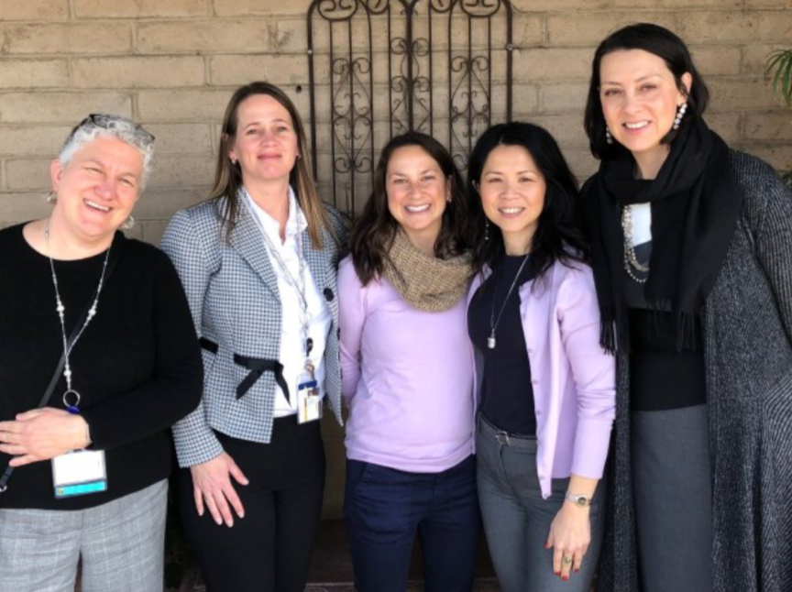
WHO WE ARE
UCD/UCDH GEIT Steering Committee
Barbara Stanton- UCDH
Leslie Olsen- UCD
Emily Marwedel- UCD
Vivian Khem- UCDH
Molly Greek- UCDH (now at UCOP)
UC DAVIS/ UC DAVIS HEALTH CENTER GEIT GROUP
Notes:
We met at UCCSC at Davis last year and attended the first women in IT track. A number of the sessions ran out of room. We saw the interest there. So, two of us from UC came together with three from UCDH to discuss concepts and check in with leadership. Also reached out to UCSB, UCLA and UCOP about what they were already doing.

Slide 6
Our Initial Questions
WHO ARE WE?
WHERE DO WE START?
WHAT WILL GUIDE US?
WHO WILL JOIN US?
UC DAVIS/ UC DAVIS HEALTH CENTER GEIT GROUP
Notes:
Our initial questions.

Slide 7
WHERE WE STARTED
Initial Steering Committee Meeting
Support from IT Leadership
Drafted Charter
UC DAVIS/ UC DAVIS HEALTH CENTER GEIT GROUP

Slide 8
JUMPING IN
“How cool is it that we have this idea?
How cool is it that we can go ahead and move forward with this idea?
That’s one of the great things about
working for UC.”
-Molly Greek
UC DAVIS/ UC DAVIS HEALTH CENTER GEIT GROUP

Slide 9
INITIAL GUIDING QUESTIONS
WHO WILL WE BE TOGETHER?
UC DAVIS/ UC DAVIS HEALTH CENTER GEIT GROUP
Notes:
We knew we wanted it to be open to all IT staff at UCD/UCDH and wanted it to feel inclusive.

Slide 10
Our Initial Questions
WHO ARE WE?
WHERE DO WE START?
WHAT WILL GUIDE US?
WHO WILL JOIN US?
UC DAVIS/ UC DAVIS HEALTH CENTER GEIT GROUP
Notes:
Our initial questions.

Slide 11
WHAT GUIDES OUR GROUP
Steering Committee
Sub Committee Leaders
Input from members
Charter
UC DAVIS/ UC DAVIS HEALTH CENTER GEIT GROUP

Slide 12
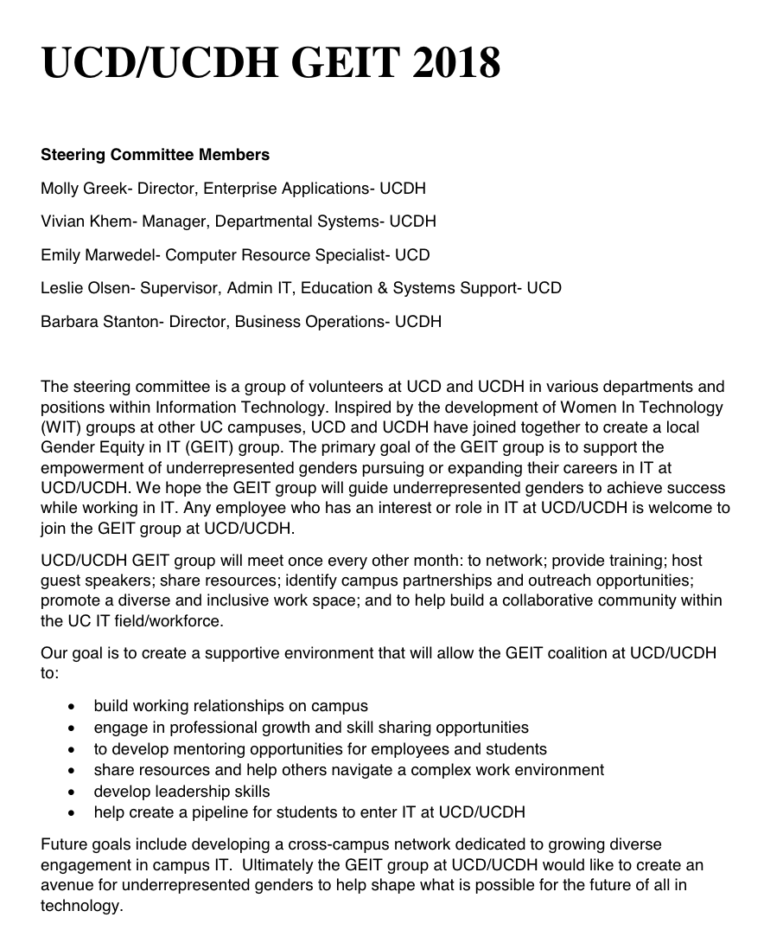
GEIT CHARTER
Our Mission
The primary goal of the GEIT group is to support the empowerment of underrepresented genders pursuing or expanding their careers in IT at UCD/UCDH
Our Goals
To network, provide training, host guest speakers, share resources, ID campus partnerships, outreach, promote diverse and inclusive work space, build a collaborative community w/in UC IT field
Looking Forward
Develop cross campus network, help shape what is possible for the future of all in technology
UC DAVIS/ UC DAVIS HEALTH CENTER GEIT GROUP
Notes:
So we drafted a charter to help outline our goals. Showing you our charter, not to test your eye sight but to show you it’s a simple as a one page description. Any employee who has an interest or role in IT is welcome to join. Aim to meet once every month.

Slide 13
Our Initial Questions
WHO ARE WE?
WHERE DO WE START?
WHAT WILL GUIDE US?
WHO WILL JOIN US?
UC DAVIS/ UC DAVIS HEALTH CENTER GEIT GROUP
Notes:
Our initial questions.

Slide 14
WHO JOINED US?
We had our first meeting
UC DAVIS/ UC DAVIS HEALTH CENTER GEIT GROUP

Slide 15
LET’S CONNECT
Who’s in the Room (or Zoom)?
Introductions
Draft Charter
Survey
UC DAVIS/ UC DAVIS HEALTH CENTER GEIT GROUP
Notes:
Sent out an email invitation for our first meeting. We had over 90 participants at our first meeting, join either in person or remotely. We had some male allies join us. A few in managerial positions wanted to know how to increase their women applicants for positions or how to best encourage current women employees to take on bigger projects. A couple of people wanted to get ideas on how to support their daughter's interest in tech and help pave the way for them.

Slide 16
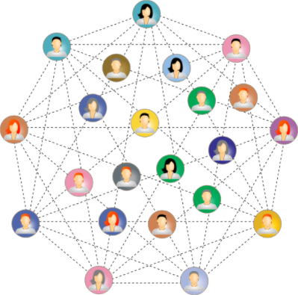
WHAT DID MEMBERS WANT?
WHAT DID MEMBERS WANT?
Based on survey results
Networking
Leadership/Professional Growth
Resources
Outreach
Collaboration
UC DAVIS/ UC DAVIS HEALTH CENTER GEIT GROUP
Notes:
After our first meeting we asked members to fill out a survey including questions about any initial feelings about the draft charter, what they hoped to gain from joining this group, what they would like to contribute to the group. These were the main interests that jumped out from the responses (~30 responses total).

Slide 17
SUB-COMMITTEES
College Student Mentoring
Jr. High & High School Outreach
Education/Resources
Guest Speakers
Recruitment
Social Events
UC DAVIS/ UC DAVIS HEALTH CENTER GEIT GROUP
Notes:
We knew we wanted it to be open to all IT staff at UCD/UCDH and wanted it to feel inclusive.

Slide 18
IDENTITY PHASE
WIT
GEIT
UC DAVIS/ UC DAVIS HEALTH CENTER GEIT GROUP
Notes:
Based on feedback from a presentation on our group, we changed the name from Women in Technology to Gender Equity in IT. We want to be inclusive and make everyone feel welcome. We altered our charter to include the new name and take out the word women and inserted the term underrepresented genders and others.

Slide 19
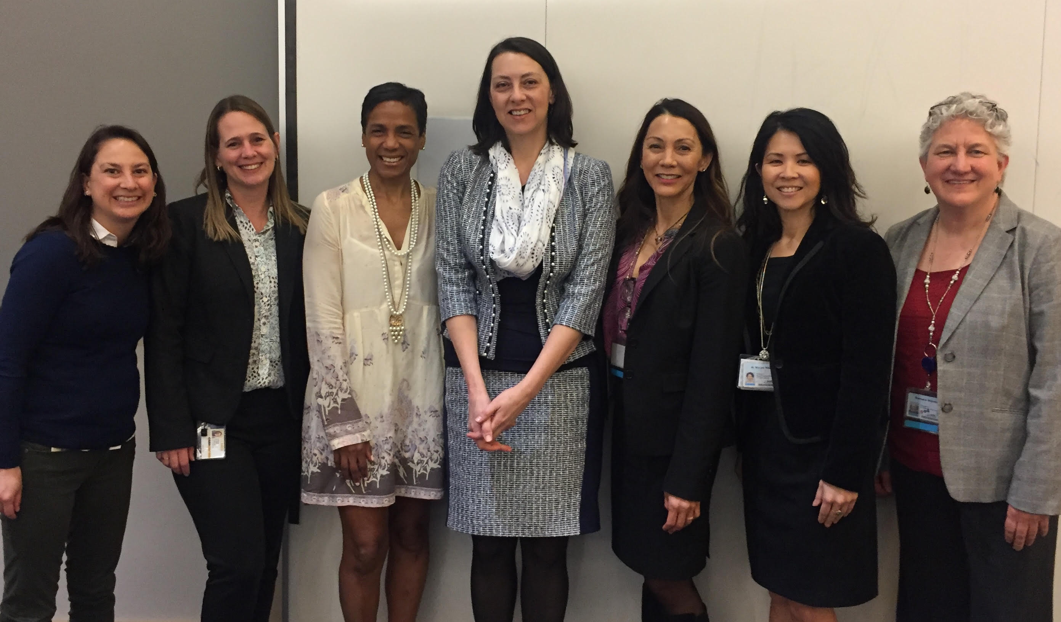
MEETING EVERY OTHER MONTH
October
Initial Meeting
December
HR Reps on how to increase the number of women applicants for IT positions
April
Special Guest Speakers
February
Sub-committees /interest discussions
June
Professional Growth
UC DAVIS/ UC DAVIS HEALTH CENTER GEIT GROUP
Notes:
We meet every other month with social events in between meetings. So far have had fairly good attendance, although the June was tough with the end of quarter so close.

Slide 20
What’s Working So Far
Enthusiasm
Connections
Collaboration between campuses
Sub committees
Communication
UC DAVIS/ UC DAVIS HEALTH CENTER GEIT GROUP
Notes:
Enthusiasm for group was amazing. Comfortable work connections are being made. Able to compare processes and resources at each campus location, UCD/UCDH. Sub committees can get ball rolling.
Communication is primarily via email & Slack for announcements. Also use Box to share resources and collaborate on docs.

Slide 21
CHALLENGES
Time
Different Locations
Defining Group
Website, funding
Safe space
UC DAVIS/ UC DAVIS HEALTH CENTER GEIT GROUP
Notes:
Time! Too little time for everyone to get together, even for steering committee. Realizing not all processes/resources are the same at each location. Defining the group/what's in a name. How do we create a group that can continue on without us? We need a website, funding, etc. How do we open the group to all and maintain it as a safe space? How do we continue to reach people? How do we convey the message that we are not just meeting up to complain about what’s not working, but rather working toward empowering each other and those coming up behind us?

Slide 22
UC COLLABORATION
This is Bigger Than Us
Met with other UC locations
Collaboration across UC’s
Working on UC WIT charter and defining mission
Actionable items to pass on to others
Sub-committees
Continuing to learn from each other
UC DAVIS/ UC DAVIS HEALTH CENTER GEIT GROUP
Notes:
In September of 2018 we had a call with a larger group with other UC locations represented. Since then have representatives from nearly all locations (UCOP, ANR, Health Centers). Still feeling out the overall mission for that group, but so far some great ideas are coming out of collaborating. As a group decided actionable items were important for those not on the call. Began creating a guide on ways to support gender equity in IT in the workplace. Sharing articles. Developing sub-committees. Working on charter. Learning from each other. Also looking into developing a resource/repository for articles and events.

Slide 23
Do You Know the WIT/GEIT Group On Your Campus?
UC ANR
UCB
UCD, UCDH
UC HASTINGS
UCI
UCLA, UCLAH
UCM
UCOP
UCSB
UCSD
UCSF
UCR and UCSC,
WHERE YOU AT?
UC DAVIS/ UC DAVIS HEALTH CENTER GEIT GROUP
Notes:
We are not the only group out there. Other campuses have established groups or are in the process of developing a group. All of these campuses listed have had a representative on a UC WIT call at some point, so someone on each of those campuses is interested in this idea. Would love to see every campus/entity represented.

Slide 24
WHERE DO WE GO FROM HERE?
Revisit Charter
Quantify Strategies That Are Working
Funding
Website
Collaborate
UC DAVIS/ UC DAVIS HEALTH CENTER GEIT GROUP
Notes:
Coming up on one year as a group and will take another look at our charter to revise as necessary. Try to find a way to quantify or monitor strategies that are successful in increasing diversity in IT. Continue collaborating with each other on campus and with other UC's. Expand our sub committee work. Continue to grow the gender equity/women in IT sessions at UC Tech conferences. Campus interest group. Receive funding. Create website.

Slide 25
QUOTE
“Alone we can do so little;
Together we can do so much.
-Helen Keller
UC DAVIS/ UC DAVIS HEALTH CENTER GEIT GROUP
Notes:
Vivian, who’s on the steering committee but not here today, likes to say “it takes a village, you know”. Together we can get so much more done. So we encourage you to connect with each other. Collaborate with each other. Work towards making the work place friendly for everybody. Support each other. And maybe sometimes reach just a little outside your comfort zone to further yourself. Continue to educate yourself.

Slide 26
Any Questions
UC DAVIS/ UC DAVIS HEALTH CENTER GEIT GROUP

Slide 27
Contact Us
Emily Marwedel- eamarwedel@ucdavis.edu
Leslie Olsen- leolsen@ucdavis.edu
Barbara Stanton- bastanton@ucdavis.edu
UC DAVIS/ UC DAVIS HEALTH CENTER GEIT GROUP
Notes:
We are not the only group out there. Other campuses have established groups or are in the process of developing a group. All of these campuses listed have had a representative on a UC WIT call at some point, so someone on each of those campuses is interested in this idea. Would love to see every campus/entity represented.

Slide 28
UC DAVIS/ UC DAVIS HEALTH CENTER GEIT GROUP

