Slide 1
Finding the Finish Line
Setting goals and reaching them

Slide 2

Hello!
We are Allison Flick & Michael Stuart
Just a couple of nerds from UC San Diego Library.
You can find us at aflick@ucsd.edu & mstuart@ucsd.edu
Geisel Library

Slide 3
Allison’s big goal
Let’s take a trip back to 2015...
Notes:
ALLISON - So let’s go back to 2015. I’ve traveled to Upstate NY to visit my father in my childhood home. As many of you may have experienced (or will experience) a decision was made that Dad needed to downsize. Big property, big house, LOTS. OF. STUFF. 35 years of stuff to be exact. But I am there and figure “Hey! Let’s get started Dad!” He’s game and I’m not leaving for 3 more days, so begins what I like to call...

Slide 4
Operation: Folly
Wherein our hero foolishly thinks she can empty an entire basement in 2 days.
Notes:
ALLISON - Operation Folly. I have no real plan, have not taken stock of the house or what should happen first, but I HAVE A GOAL and I am MOTIVATED.

Slide 5
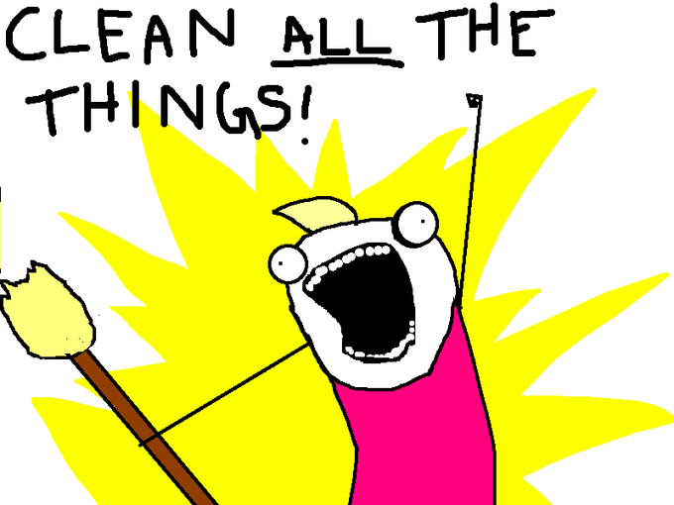
Notes:
ALLISON - We march into the basement full of energy and misguided dreams. Day 1 lasts for about 4 hours. We’re moving piles around but wasting energy and not making much headway.

Slide 6
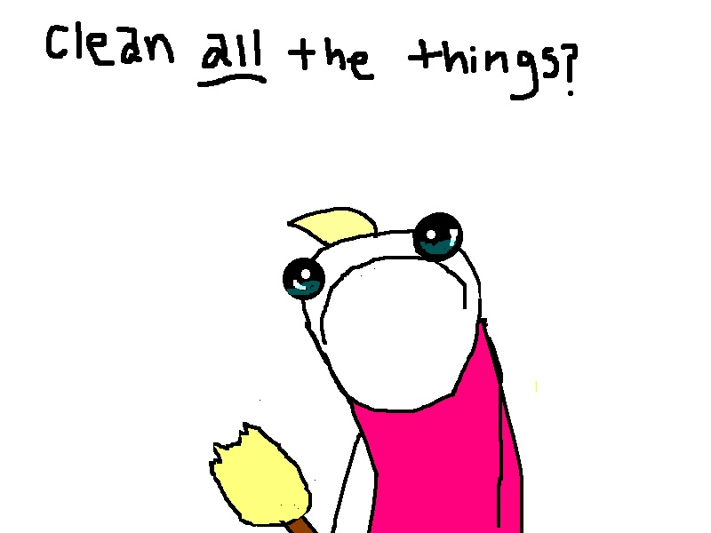
Notes:
ALLISON - On day 2 we realize we have miscalculated. What are we doing? How are we going to accomplish all this? We have a goal but no discernible path to reaching it.

Slide 7

So what went wrong?
Notes:
Allison - By day 3 we’re burned out and we’ve put our goal to the wayside in favor of Star Wars and pizza.
So what went wrong? Why was I not able to accomplish my goal? In this circumstance I had a very specific goal but I was unprepared and had an unrealistic objective & timeline which, in the end, lead to abandonment of the goal in favor of a sausage & mushroom pizza.

Slide 8
Why are we here today?
Background and context
Support and sponsors
The role of a supervisor
Finding motivation
Creating effective goals
.
Notes:
ALLISON - In this talk we’ll be discussing how to set a goal that can be maintained, nurtured and ultimately achieved. Setting any goal for yourself requires intention, planning, accountability and realism.
MICHAEL - We’ll be talking about why we create goals, how to create a circle of trusted peers that can help you with your goals, what the role of a supervisor is in goal setting, how to find your motivation and finally we’ll go over how to create an effective goal together.

Slide 9
Background & Context
1
Why we need goals and their role in our success
Notes:
ALLISON - Effective goals help us bring our ideas into reality. Many times we can get bogged down by life...

Slide 10
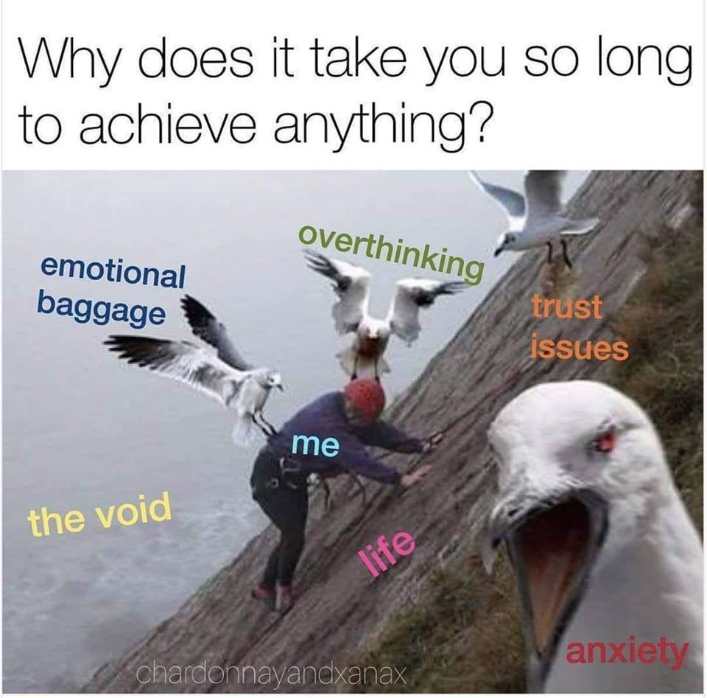
Notes:
ALLISON - ... and accomplishing goals can seem overwhelming. When this happens it’s time to get serious about your goal and typically that is because you’ve reached the tipping point between interest and intent.

Slide 11
Interest vs. Intent
Interest
(n.) the state of wanting to know or learn something.
(adj.) to excite curiosity or attention (of someone)
Intent
(n.) intention or purpose
(adj.) resolved or determined to do something
Notes:
ALLISON - The difference between intent and interest is need and resolve. You experience this every time you look in your Dad’s basement and recoil in horror. When this happens, you’re no longer idly interested in de-cluttering --that interest has converted to intent because of need.
With need comes urgency that lends us motivation to do something.

Slide 12
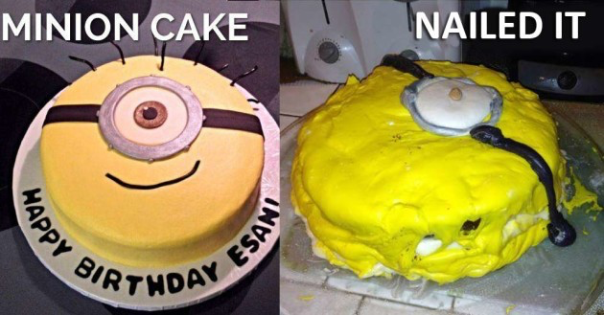
You need clear intention to have a quality outcome
Notes:
ALLISON - You may be interested in baking a minion cake, but if you’re serious about a realistic goal you’ll want to set a clear intention for what you want to do and a roadmap for how to get there. Muddy, unregulated intention will greatly impact the outcome of your goal… resulting in whatever that nightmare is.

Slide 13

Goal setting bridges the divide between intention and outcome
Notes:
ALLISON - This is why we make plans and structure them. To bridge the difference between intention and outcome.

Slide 14
Alignment of goals
Organization
Department
Personal
Notes:
MICHAEL - It is critically important to plan you goals and understand how they feed into the larger picture: the vision and mission of your organization. Being able to link personal, departmental, and organization goals can help translate something tactical into something strategic...this is key for elevator pitches and explaining to management teams. Goals that may not be perfectly aligned may still be useful, but we still need to think in this context.

Slide 15
Goals and practice have different horizons
Micro
Spending 15 minutes a day reading a professional publication or journal.
Macro
Thinking 4 levels down the line to attain a CIO position at a university.
Notes:
MICHAEL - Thinking in different time horizons can be very helpful in decomposing goals. Be careful to frame goals and be clear if you are talking about objective, strategy or tactics. Each has a role. The micro example is a tactic, the macro example is an objective.

Slide 16
What got you here, may not get you there.
Notes:
MICHAEL - We need to be mindful that our goal setting skills need to evolve just as our careers do. Patterns and previous experience may not be enough in some cases, so we need to grow. The example I like to think of here is the false summit. Climbing a mountain peak, only to discover that there is yet another taller peak beyond it. This isn’t a bad thing! This is us growing.

Slide 17
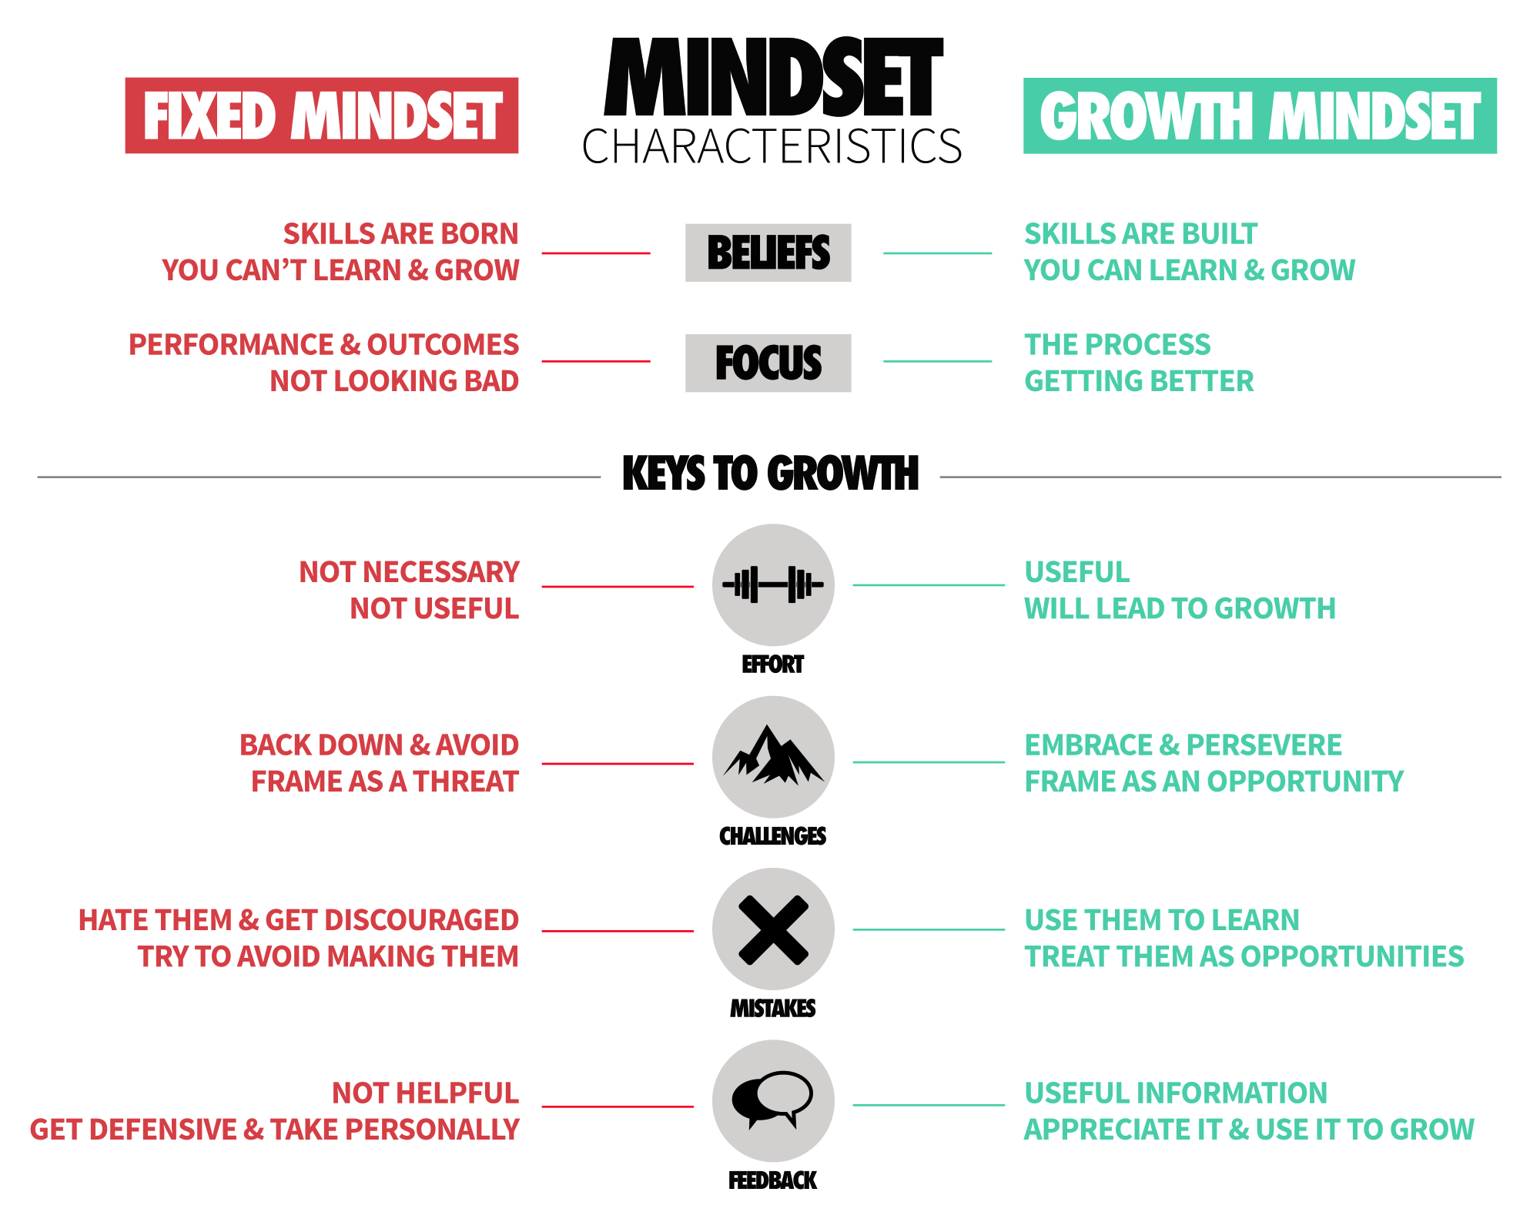
Notes:
MICHAEL - Growth isn’t something we need to do sometimes, it’s something we need to adopt. Embracing a growth mindset is key. It takes effort and time, especially getting to know yourself and your patterns that help/hurt you. Don’t be afraid to try, even if you fail. Failure gives you lots of opportunity to learn. Failure is not a bad word.

Slide 18

Feedback loops are critical
Notes:
MICHAEL - Embrace feedback loops to incorporate small, regular and effective improvements in whatever your goal is. It isn’t just enough to have a goal, we need to converge action + effort. The result is concept called deliberate practice. An example might be you want to get better at facilitating meetings. You’ve got an opportunity to step up and run a small project that has weekly meetings. You call on a trusted advisor to give you honest feedback after each meeting and you reflect on how you can incorporate that feedback into the next meeting. This can be applied to many other examples: fitbits & sleep trackers offer daily / hourly feedback.

Slide 19
Support and Sponsors
2
Harness the power of people to help you reach your goals
Notes:
ALLISON -

Slide 20
Goal setting really starts with the individual, no one can do it for you, but there are plenty of people who can help.
Notes:
Allison Read quote.

Slide 21

We all need a collection of trusted advisors
A dynamic community of people we can rely upon for honest feedback, advice, learning, and listening.
Notes:
ALLISON - Why is it important to have a trust circle

Slide 22


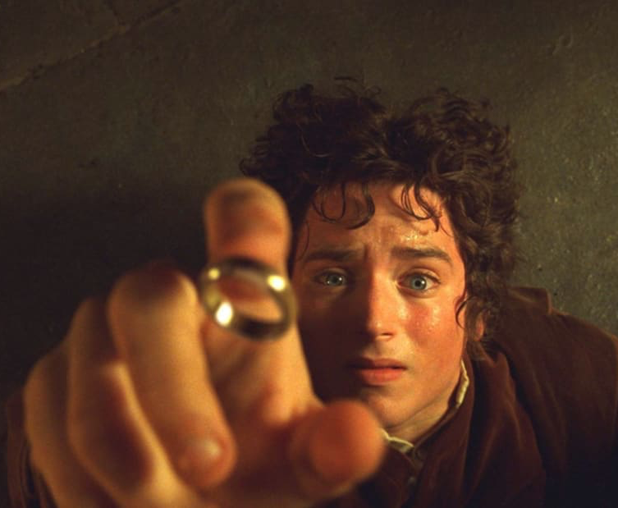
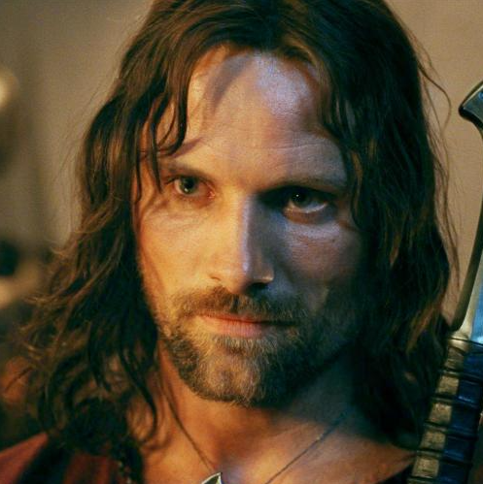
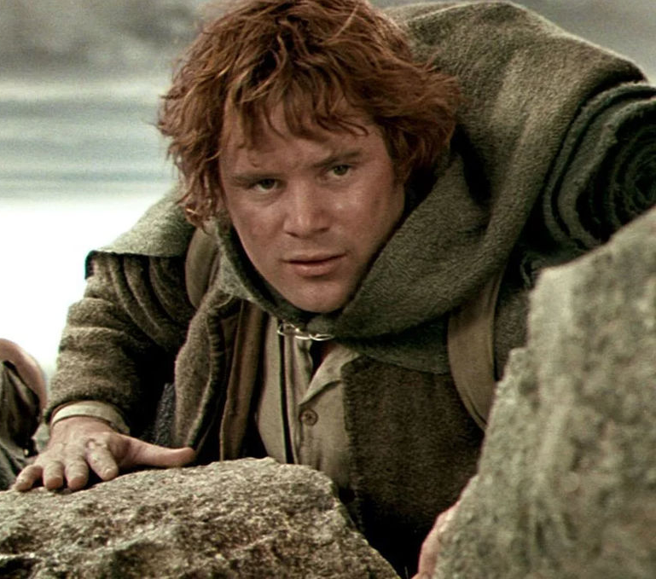
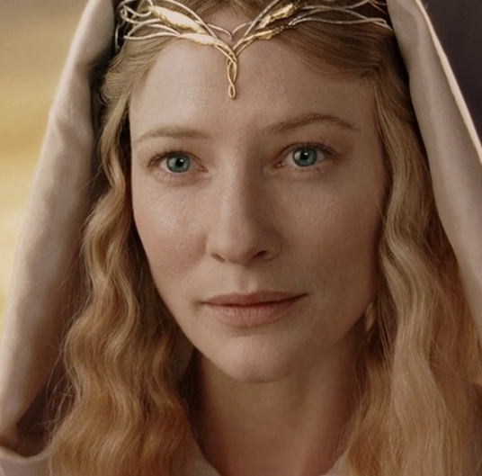
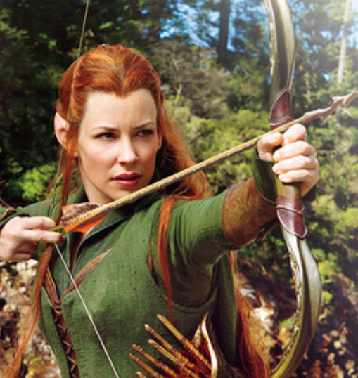
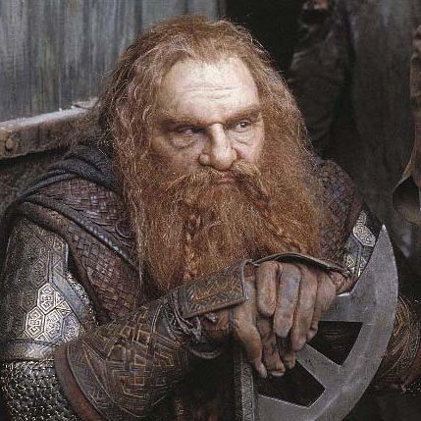
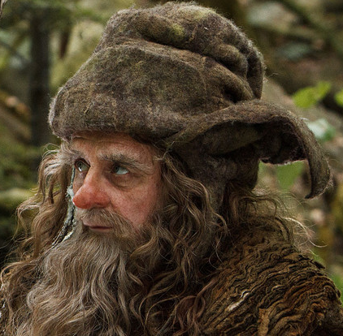
Frodo, alone?
We rarely every accomplish our goals without help of others
Notes:
ALLISON -
You need to tell people your actual goal if you want your advocates to work for you.
Conversations to conversion
Make it real with advocates

Slide 23
What does your trusted circle look like?
Peers
Mentor
Any group, person, organization supporting your goals
Supervisor
Advocacy Group
Notes:
Michael - A trusted circle is a confluence of important individuals and groups in your life. There isn’t a perfect size or composition, but there is one key theme: all members of YOUR circle should be YOUR advocate.
Allison - What does a trust circle look like and how to find these people in your life. Example of WiAC

Slide 24
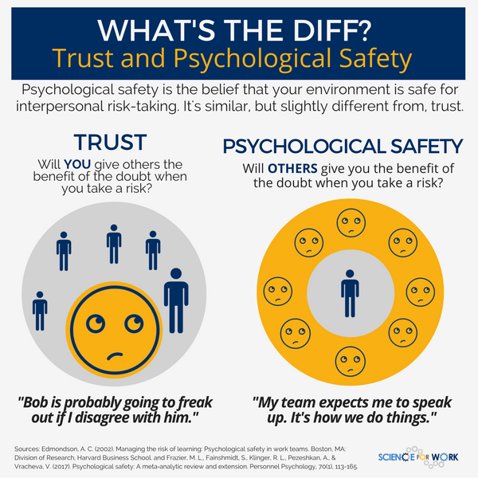
What is true trust?
Deep levels of trust and authenticity are critical for trusted advisors.
Notes:
MICHAEL - Basic trust covers basic safety needs (no one is going to poke me in the eye), but psychological safety means: you can be vulnerable, take risks and listen/provide critical feedback because you know WITHOUT a doubt you are in a truly safe space. This concept is often talked about within the context of work teams, but is also applies and takes on deeper meaning in our trusted circles.

Slide 25
How much psychological safety does your trusted circle provide?
Peers
Mentor
Any group, person, organization supporting your goals
Supervisor
Advocacy Group
Notes:
MICHAEL - Think back to your trusted circle now, take 5 seconds, how much psychological safety does your trusted circle provide? Quick show of hands, who thinks they could use some more?
Allison - Comment to tie back to WiAC circle

Slide 26
Tips on building trusted circles
Start local: the opportunities are there
  Your Team, Department, Campus, Community
Be open and remember it's ok to be vulnerable
Embrace opportunities for micro mentorship
  You might also be able to help someone in your situation, so keep an eye out
Think about the context/horizons
  Immediate project/skill, outcome, facilitation
Notes:
MICHAEL - Here are some tips when it comes to thinking about how to build your trusted circles.
Allison

Slide 27
Are you a supervisor?
3
The critical role a supervisor plays
Notes:
MICHAEL - This next section is for all the supervisors and managers out there!

Slide 28
Focal points for supervisors
Pay it forward
Carve out time for people
  Not just for day-to-day, but for goals (long & short)
Are you asking good questions?
  Reflection, illumination, true understanding
Do you have the resources? Need more?
  There are plenty and it’s your job to look for them!
Talk with other supervisors
Notes:
MICHAEL - The importance of reviewing goals with employees. Not everyone will interested in goal setting (especially longer term goals) but it’s important for supervisors and employees to have a forum for discussion.

Slide 29
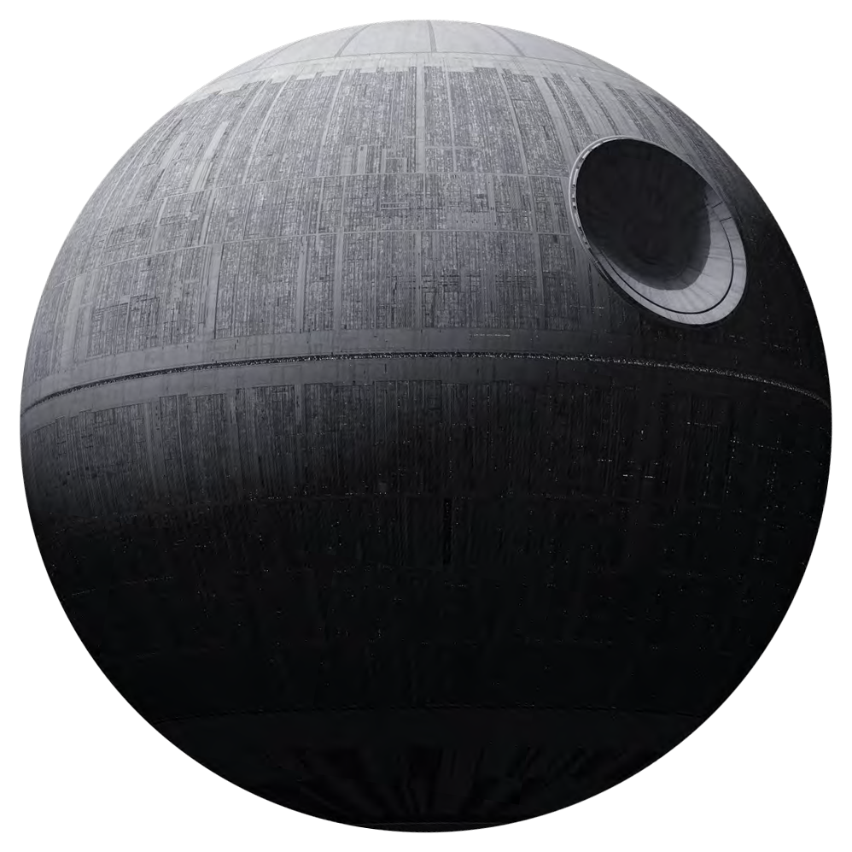
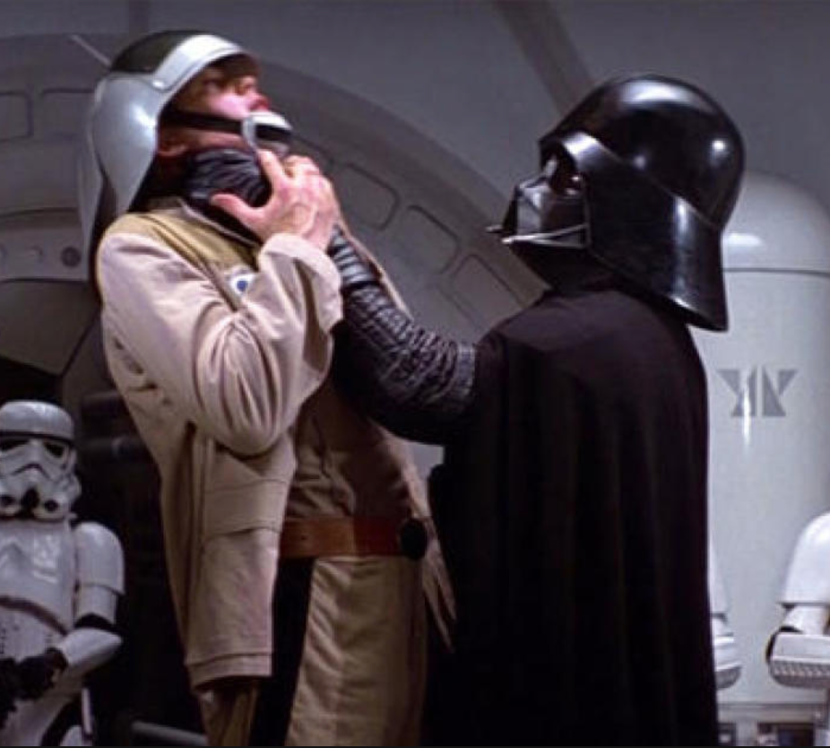
Be careful you aren’t too ambitious with organizational goal setting
Notes:
ALLISON - As a supervisor it’s common to set stretch goals for your department or organization. It’s critically important to be mindful of unintended consequences in your goals. (i.e. Goals Gone Bad). When people focus on a specific stretch goal, and fail to perform other valued activities that are needed by the organization, goals are failing.
When employees care exclusively about reaching a goal,CLICK and bad things can happen if they fail, unethical behavior goes up.

Slide 30

We all remember how THOSE goals worked out...
Notes:
ALLISON - If you know the exact specific behaviors you want, stretch goals may be just fine. But, if you want employees to engage in other pro-social behaviors (e.g., helping others in the organization) and/or to act ethically, you need to be a lot more careful than simply providing a stretch goal. Additionally, there is a growing set of research that shows "learning or mastery" goals have much more positive effects on performance and internal motivation than "performance" goals.
https://www.forbes.com/sites/markmurphy/2018/04/15/neuroscience-explains-why-you-need-to-write-down-your-goals-if-you-actually-want-to-achieve-them/#41711bf67905

Slide 31
The most important thing you can do is listen and enable
Give Air time
Even making time, doesn’t mean our employees always have the “air time” in meetings to talk. Make sure to allow plenty of time for them to share.
Be Curious
Allow for curiosity and exploration in the conversation. This is the time for you to understand the context and motivation of employee goals.
Seek a Deeper Understanding
Asking open-ended questions with less precise (e.g., one word) answers can help open the floor for someone to expand/share more.
Notes:
MICHAEL - A lot of times as supervisors and managers, we tend to be on the giving-end for advice or technical expertise. We’ve got to remember if we are talking, there is no way we are listening. Also, remember the setting matters. Physical spaces like formal conference rooms where conversations are fast paced and intense can influence the meeting style. Try changing up the location to a more casual location (coffee or on-the-go). Also, remember you are trying to connect a person not just a goal.

Slide 32
How can we help prepare our staff for a goal conversation and what does it even sound like?
Notes:
MICHAEL - The importance of reviewing goals with employees. You’ll need to find a rhythm and mode for your team, but it all starts with good preparation and that means giving them time to prepare and think. A surefire way to get someone to worry: “We need meet about your goals”. Again, “Don’t be Darth”!

Slide 33
Starting a conversation:
What does that sound like?
Supervisor
Hi Allison! Fantastic job getting that crazy deployment taken care of. I know you have a ton on your plate, but let’s talk next week about that super innovative idea you had...that is such a great goal! I’d really like to help...
Employee
Hi Michael! I would love to have a one-on-one next week. I’ve been thinking about where I would like my career to go in the future and would really benefit from creating a goal setting plan together.
Notes:
MICHAEL - Sup side: Be open, be positive, offer to help, use it as an opener. Be mindful of the horizon, the longer means more time and context.
CLICK
ALLISON - Employee side: Understand that your supervisor may not always be aware of your goals within your organization.
ALLISON - A note, don’t expect both sides to be excellent at having a conversation like this….

Slide 34
What if I don’t know where to start?
!
You are not alone and there are plenty of tools to get started
Notes:
MICHAEL - Sometimes in the course of our careers, medium-to-longer goals can escape us. It happens to different people at different times.

Slide 35
Tips for finding direction
Follow curiosity and intrigue
Find opportunities for exposure & exploration
Think in shorter horizons (week, month, year)
Explore your strengths: CliftonStrengths
  Connect what you are passionate about with a strength or development opportunity
Broaden your base: try something totally new
Notes:
MICHAEL - Here are some short tips to help you find a direction if you feel stuck or need some inspiration or reframing.

Slide 36

S.M.A.R.T. Goals
Specific
Measureable
Action-oriented
Realistic
Timed
Notes:
ALLISON
Any goal worth having doesn’t take an hour, or even one day, to come up with. You don’t want to cram for this one. Goals require a lot of thinking, brainstorming, list-making, and synthesizing of all the knowledge and data you have access to. The journey is just as important as the destination. One way to do this is to use the SMART methodology.
Harken back to beginning of talk with a SMART methodology

Slide 37
Tips for gaining and keeping momentum
Key is accountability (for yourself)
Are you internally or externally motivated?
Write down your goals and make them visible
  Review regularly!
Follow through with a buddy or group
Simply talking about your goals
Notes:
MICHAEL - Here are a few tips on translating that intention into outcome.

Slide 38
Let’s get to it!
A practical exercise for setting goals
Notes:
Allison - I would like for you to defer judgement on your own goals. Try and silence that negative voice in your head.
The “five-fingered goal” One goal in the middle with 5 ways to help you accomplish that goal.

Slide 39
Building a goal
BUILD
TO
YOUR
GOAL
WAYS
GOAL
Notes:
Allison - Each action is specifically linked to an outcome that directly support your goal.

Slide 40
Time to share
Please be respectful of others and help them on their journey
Notes:
Michael - Quick ground rules before we share: be an advocate for your peers in this room.
Allison - Facilitate sharing.

Slide 41
Thanks!
Any questions ?
You can find us at
Allison Flick | aflick@ucsd.edu
Michael Stuart | mstuart@ucsd.edu
Notes:
Allison - Recap, closing.
Michael - Thank you for your time and participation today...and remember Don’t be Darth, either for your staff or for yourself!

