Slide 1
Dockerized Shibboleth, the Holy Grail?
Carol Brothers
Senior DevOps Engineer
Email: carol.brothers@ucop.edu
Phone: (510) 587-6224
University of California, Office of the President
300 Lakeside Drive, 12th floor, 12216
Oakland, CA 94612
Steve Hunter Senior DevOps Engineer
Email: steven.hunter@ucop.edu Phone: (510) 987-0138 University of California, Office of the President 300 Lakeside Drive, 12th floor Oakland, CA 94612
Notes:
Introduce yourself - tsr 80

Slide 2
The Mission
Move a production web application to the cloud (AWS in particular)
Employee best practice design and operations
CD/CI
Infrastructure as code
Cloud services whenever possible
Poster child app for future move of entire portfolio to AWS
TOPIC Dockerized Shibboleth, the Holy Grail?
Notes:
Tell your story about infrastructure as code before sliding

Slide 3
The Application
Infrastructure:
Apache
mod_jk: tomcat connector
mod_shib: Shibboleth Service Provider plugin
Tomcat
Code:
Java
Spring MVC, Spring Security, Hibernate
Execution environment:
Linux VM
Hosted at SDSC
TOPIC Dockerized Shibboleth, the Holy Grail?
Notes:
Tell your story about infrastructure as code before sliding

Slide 4
The Design
Dockerize apache and tomcat
Code pipeline
Define as a CloudFormation template
TOPIC Dockerized Shibboleth, the Holy Grail?
Notes:
Tell your story about infrastructure as code before sliding

Slide 5
The Problem
Getting mod_shib working an configured properly inside a docker container
TOPIC Dockerized Shibboleth, the Holy Grail?
Notes:
Tell your story about infrastructure as code before sliding

Slide 6
What is Docker?
Packaging technology that allows OS, libraries, and application code to be layered together
Container executes on any Docker engine
Alleviates problems with environmental differences between systems, say, dev and prod
Infrastructure includes repository to store containers, making them reusable
All major open source projects have reference containers that you can start with, e.g. tomcat, nodejs, nginx, etc.
TOPIC Dockerized Shibboleth, the Holy Grail?
Notes:
Tell your story about infrastructure as code before sliding

Slide 7
What is Docker?
Containers defined by a Dockerfile, which lists the starting container and all the layers you wish in include in your container
You define networking, parameters, and startup scripts here as well
TOPIC Dockerized Shibboleth, the Holy Grail?
Notes:
Tell your story about infrastructure as code before sliding

Slide 8
What is Docker?
Engine allows inter-container and container-outside networking
This enables containers to be treated as building blocks
Example: One container runs CDN app on Ruby on Rails, another Lucene as indexing against content
TOPIC Dockerized Shibboleth, the Holy Grail?
Notes:
Tell your story about infrastructure as code before sliding

Slide 9
What is Docker?
FROM debian:stretch-slim
LABEL maintainer="NGINX Docker Maintainers <docker-maint@nginx.com>"
ENV NGINX_VERSION 1.17.1
ENV NJS_VERSION 0.3.3
ENV PKG_RELEASE 1~stretch
# forward request and error logs to docker log collector
RUN ln -sf /dev/stdout /var/log/nginx/access.log \
&& ln -sf /dev/stderr /var/log/nginx/error.log
EXPOSE 80
STOPSIGNAL SIGTERM
CMD ["nginx", "-g", "daemon off;"]
TOPIC Dockerized Shibboleth, the Holy Grail?
Notes:
Tell your story about infrastructure as code before sliding

Slide 10
AWS Docker Services
Elastic Container Repository (ECR)
Elastic Container Service (ECS)
Entails running a full EC2 instance
Fargate
ECS as a service
No visible EC2 instances
Lower cost
Application more opaque
TOPIC Dockerized Shibboleth, the Holy Grail?
Notes:
Tell your story about infrastructure as code before sliding

Slide 11
What is Shibboleth?
is any custom or tradition, a phrasing that distinguishes one group of people from another. Shibboleths have been used throughout history in many societies as passwords, simple ways of self-identification, signaling loyalty and affinity, maintaining traditional segregation, or protecting from real or perceived threats.
The modern use derives from an account in the Hebrew Bible, in which pronunciation of this word was used to distinguish Ephraimites, whose dialect used a differently sounding first consonant.
TOPIC Dockerized Shibboleth, the Holy Grail?
Notes:
ee fray ihm ait

Slide 12
Shibboleth Single Sign-on and Federating Software
Shibboleth is an open-source project that provides Single Sign-On capabilities and allows sites to make informed authorization decisions for individual access of protected online resources in a privacy-preserving manner.
InCommon operates the identity management federation for U.S. research and education. Through InCommon, Identity Providers can give their users single sign-on convenience and privacy protection, while online Service Providers control access to their protected resources.
Dockerized Shibboleth, the Holy Grail?
Notes:
define Shibboleth 2000 to facilitate sharing of resource with incompatible authentication

Slide 13
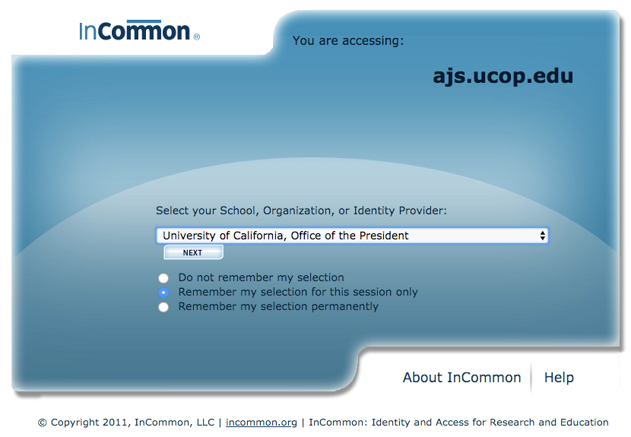
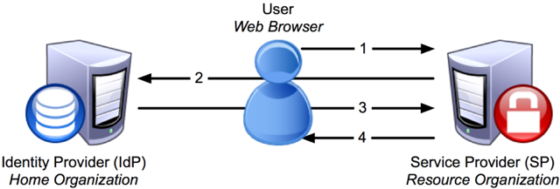
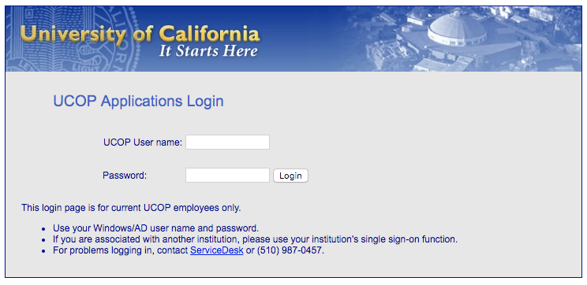
Dockerized Shibboleth, the Holy Grail?
Notes:
define

Slide 14
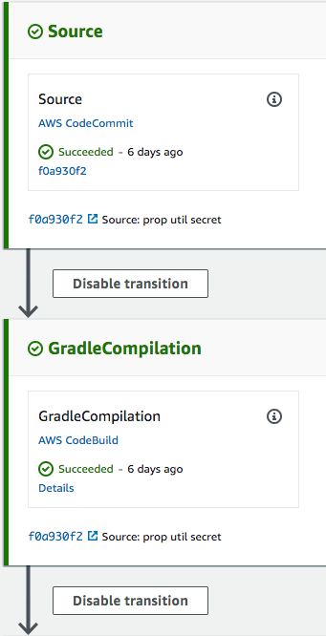
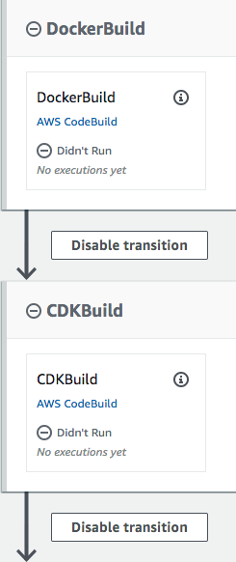
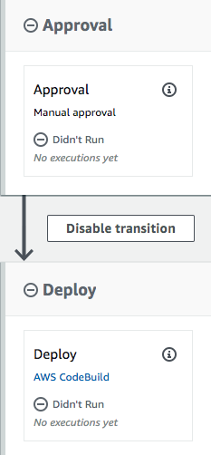
AWS CODEPIPELINE
Notes:
describe stages

Slide 15
AWS Services
DOCKER
ECR
ECS
FarGate
Auto Scale
Infrastructure
Route53
Elastic Load Balancers
RDS
Secrets Manager
Lambda
Network
CloudWatch
S3
Certificate Manager
SES
Security
IAM
Config
CloudTrail
GuardDuty
Billing and Cost
CI/CD
CloudFormation
CodeCommit
CodePipeline
CodeBuild
Cloud9
TOPIC Dockerized Shibboleth, the Holy Grail?
Notes:
ee fray ihm ait

Slide 16
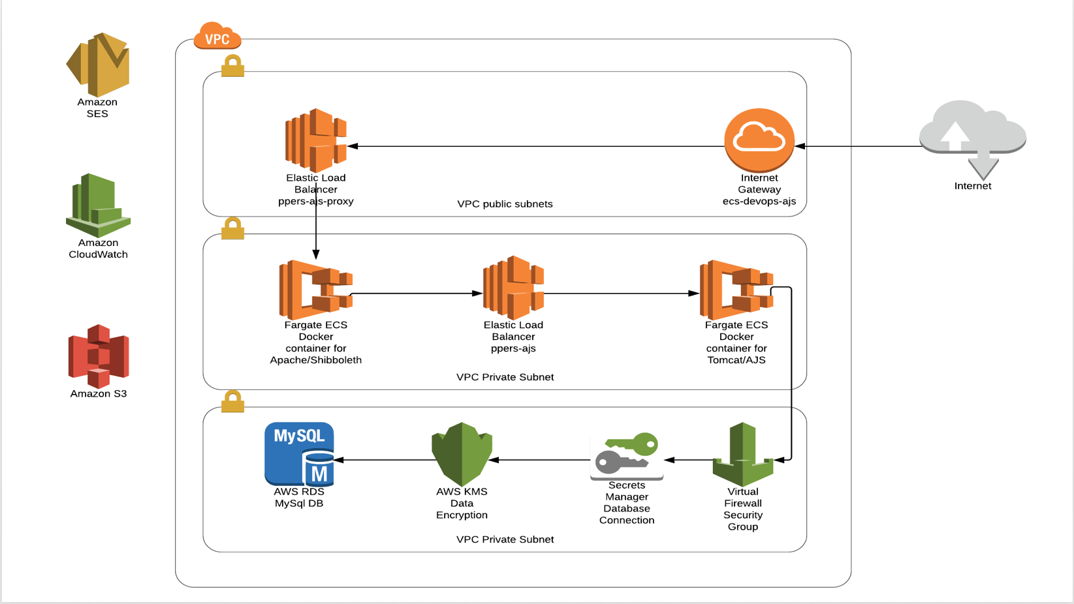
Dockerized Shibboleth, the Holy Grail?
Notes:
define

Slide 17
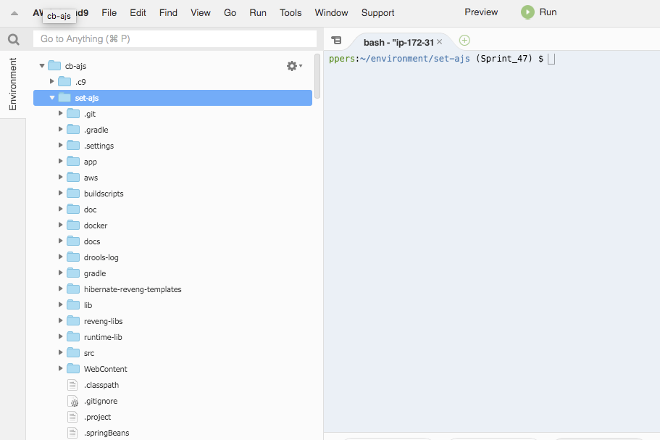
TOPIC Dockerized Shibboleth, the Holy Grail?
Notes:
Tell your story about infrastructure as code before sliding

Slide 18
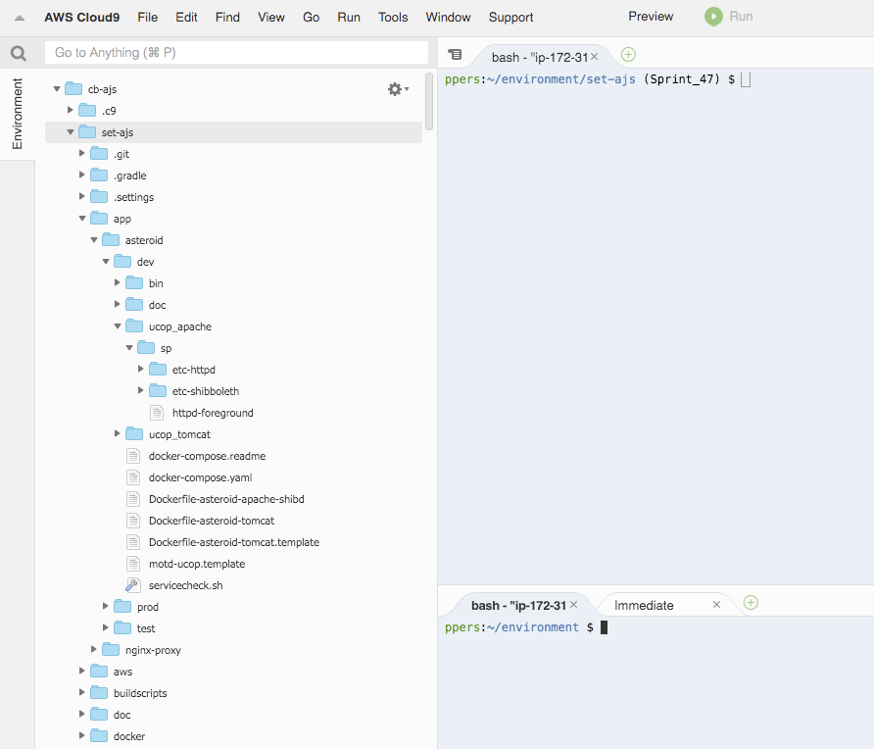
Dockerized Shibboleth, the Holy Grail?
Notes:
define

Slide 19
SP is Service Provider is our app shib configuration
IdP is campus identity provider
InCommon is the metadata broker/coordinator
For different env/app, rename all ajsdev to ajsqa (dns entries) in:
sp/etc-httpd/conf.d/sp.conf
sp/etc-shibboleth/shibboleth2.xml
TOPIC Dockerized Shibboleth, the Holy Grail?
Notes:
Tell your story about infrastructure as code before sliding

Slide 20
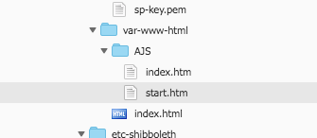
Change main pages in sp/etc-httpd/var-www-html
Attributes in attributes.xml - request from your campus IdP to release specified attributes you need. For example, Shib-emailAddr, Shib-eppn, Shib-displayName that you will check for and use in your application.
Create Shibboleth ssl certificate by doing:
sudo /etc/shibboleth/keygen.sh -f -h ajs.ucop.edu -e https://ajs.ucop.edu/shibboleth -o /etc/shibboleth -u shibd -g shibd
TOPIC Dockerized Shibboleth, the Holy Grail?

Slide 21
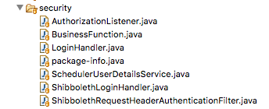
Modify your application to check the https header for the attributes you need.
Shibboleth RequestHeaderAuthenticationFilter
Handles for Shibboleth request headers to create Authorization ids.
ShibbolethLoginHandler
Interface for pre-login handling. These events occur after the Id is found, and before
UserManager attempts a login of the user.
LoginHandler
Handles creation and updating of user account details when authenticating a user.
TOPIC Dockerized Shibboleth, the Holy Grail?
Notes:
Tell your story about infrastructure as code before sliding

Slide 22
Dockerfile-asteroid-apache-shibd:
FROM centos:centos7
MAINTAINER Carol Brothers
RUN yum -y update \
&& yum -y install wget \
&& wget http://download.opensuse.org/repositories/security://shibboleth/CentOS_7/security:shibboleth.repo -P /etc/yum.repos.d \
&& yum -y install httpd mod_ssl shibboleth \
&& yum -y clean all
COPY ucop_apache/sp/etc-shibboleth /etc/shibboleth/
COPY ucop_apache/sp/etc-httpd/ /etc/httpd/
COPY ucop_apache/sp/etc-httpd/var-www-html/ /var/www/html/
COPY ucop_apache/sp/httpd-foreground /usr/local/bin/
RUN chown shibd.shibd /etc/shibboleth/sp-cert.pem
RUN chown shibd.shibd /etc/shibboleth/sp-key.pem
RUN chown shibd.shibd /etc/shibboleth
RUN chmod 600 /etc/shibboleth/sp-key.pem
RUN chmod 644 /etc/shibboleth/sp-cert.pem
RUN test -d /var/run/lock || mkdir -p /var/run/lock \
&& test -d /var/lock/subsys/ || mkdir -p /var/lock/subsys/ \
&& chmod +x /etc/shibboleth/shibd-redhat \
&& echo $'export LD_LIBRARY_PATH=/opt/shibboleth/lib64:$LD_LIBRARY_PATH\n'\
> /etc/sysconfig/shibd \
&& chmod +x /etc/sysconfig/shibd /etc/shibboleth/shibd-redhat /usr/local/bin/httpd-foreground
RUN echo "SELINUX=disabled" > /etc/selinux/config
EXPOSE 443
CMD ["httpd-foreground"]
TOPIC Dockerized Shibboleth, the Holy Grail?
Notes:
Tell your story about infrastructure as code before sliding

Slide 23
httpd-foreground
#!/bin/bash
# Apache and Shibd gets grumpy about PID files pre-existing from previous runs
rm -f /etc/httpd/run/httpd.pid /var/lock/subsys/shibd
# Start Shibd
/etc/shibboleth/shibd-redhat start
# Start httpd
exec httpd -DFOREGROUND
TOPIC Dockerized Shibboleth, the Holy Grail?
Notes:
Tell your story about infrastructure as code before sliding

Slide 24
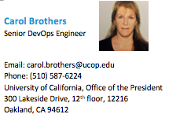
QUESTIONS?
Steve Hunter Senior DevOps Engineer
Email: steven.hunter@ucop.edu Phone: (510) 987-0138 University of California, Office of the President 300 Lakeside Drive, 12th floor Oakland, CA 94612
TOPIC Dockerized Shibboleth, the Holy Grail?
Notes:
Questions?

Slide 25
Dockerized Shibboleth, the Holy Grail?
Notes:
define

Slide 26
TOPIC Dockerized Shibboleth, the Holy Grail?
Notes:
Tell your story about infrastructure as code before sliding

