Slide 1
Rethinking Medical Research
lessons on kubernetes from the research and cloud computing trenches
July 16, 2019 | Pavan Gupta

Slide 2
Pavan Gupta
Technical Architect, Center for Digital Health Innovation
pavan.gupta@ucsf.edu
@pavgup
Active Projects:
Artificial Learning and Intelligence Compute Environment (ALICE)
Novel Advanced Machine Learning for Pediatric Application
Wynton Plus, High Performance Computing Containerization
Previous Projects:
Amazon Research Cloud (ARC)

Slide 3
An Agenda in Hard Fought Lessons
Lesson 0: Rethinking Cloud Computing
Lesson 1: Zero trust by nature
Lesson 2: Cloud native, on-prem
Lesson 3: Containerization bets are paying off
Lesson 4: Engineering for research is different

Slide 4
0. Rethinking Cloud Computing

Slide 5
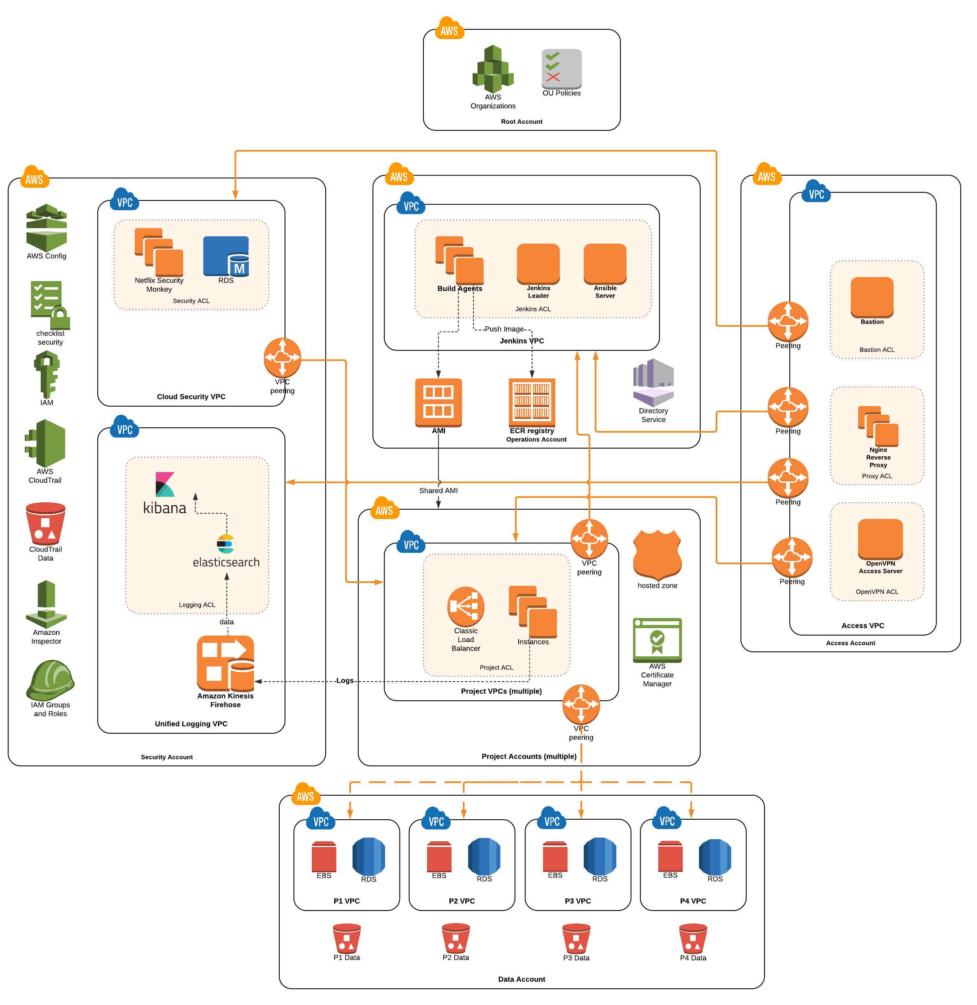
Amazon in Retrospect
Amazon Research Cloud has allowed faster research and innovation almost immediately
The project has graduated from a single department into a broad departmental collaboration with excellent new owners (SOM Tech)
AWS is dangerous, Users move quickly, and synchronous controls are burdensome
Amazon lacks a reasonable cost model for Grant-based research work
Security
Operations
Projects

Slide 6
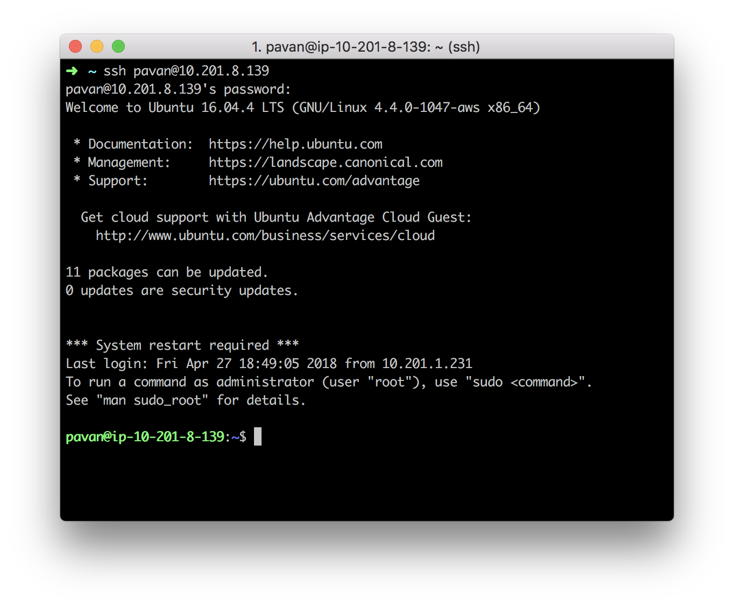
Keep It Simple, Stupid.

Slide 7
Regaining Infrastructure Control with K8S
Amazon Elastic Kubernetes Service (North Hall - Room 1109, Wed, Jul 17 from 4:00pm - 4:45pm)
Wynton High Performance Computing via Singularity (UCEN - State Street Room, Tue, Jul 16 from 11:00am - 11:45am)
Bare Metal Kubernetes…

Slide 8
1. Zero Trust by Nature

Slide 9
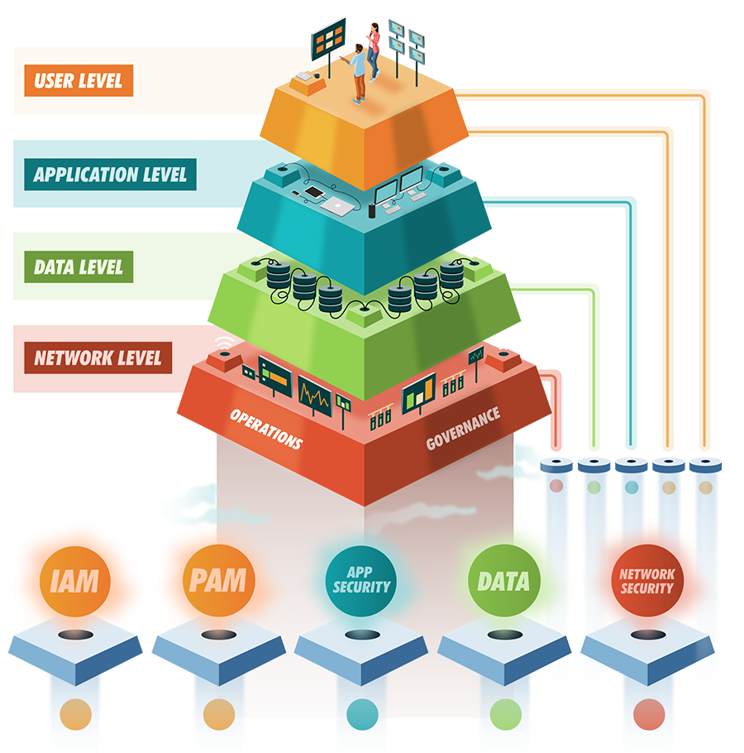
What is Zero Trust? Why do we need it?
UCSF internal and external networks may or may not be safe
Research needs to move quickly and be lightly burdened by security problems
Isolate users as a feature and guard every gate going down the compute stack
Image from https://silasg.com/

Slide 10
CDHI Research Compute Environments
Today
Statically Virtualized via Sandler/MAC model
Statically built SDN stack immediately above bare metal
Statically connected to a robust NFS backend
Identity centrally managed via FreeIPA
Tomorrow (AuthZ/N + Isolate All Things!)
Bare Metal as provided by Sandler/CDHI
Kubernetes Dynamic API Driven Resources (more on this in a moment)
OCI: Docker
CNI: Calico + Calico Polices
CSI: Ceph + Legacy NFS
Identity centrally managed via FreeIPA

Slide 11
2. Cloud native, on-prem

Slide 12
What is Cloud Native?
At CDHI, we choose Kubernetes (K8S), Docker (OCI), Ceph (CSI), and Calico (CNI) and we’re looking to our parent and peers to let us move our compute

Slide 13
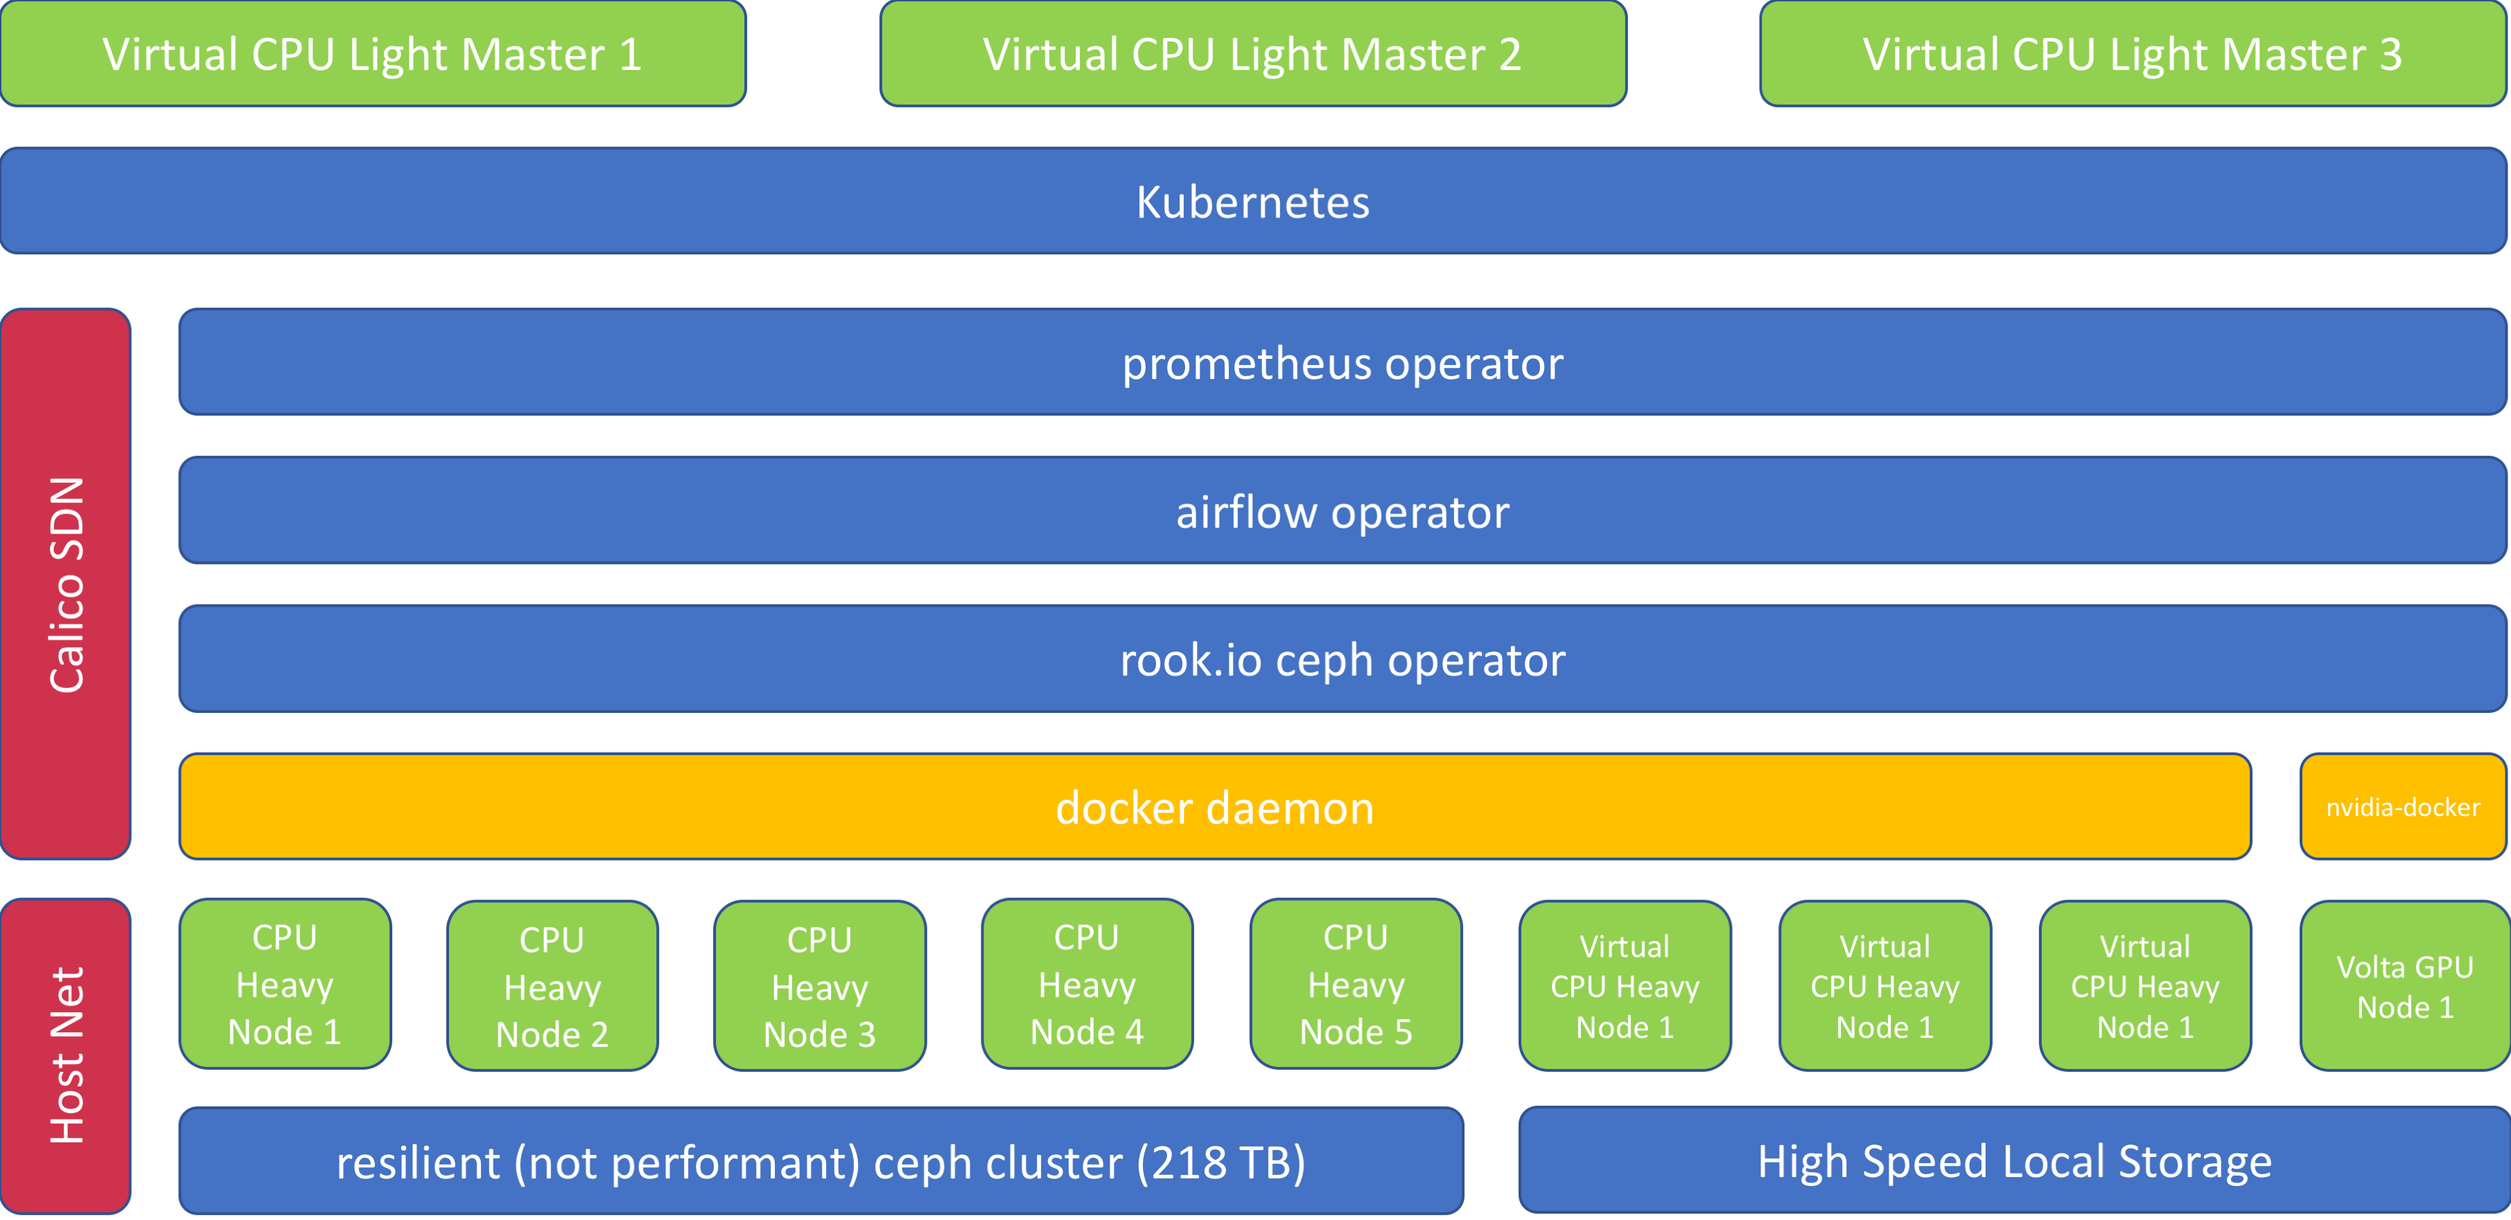
Delivering Cloud Native without the Cloud via ALICE

Slide 14
Quick ALICE highlights
440 Physical E5-2699 v4 CPU Cores
2720 Tensor Cores / 4 V100 Devices
48 Virtual Broadwell CPUs (Burst Test)
2009 GB of Physical RAM
128 GB of Physical Video RAM
360 GB of Virtual RAM (Burst Test)
218 Terabytes of CEPH Storage
2983 Gigabytes of Local Storage

Slide 15
3. Containerization bets are paying off

Slide 16
Containerization as a Research Method
Develop fully containerized research methods; repeatable by convention
Use cloud native object storage to maintain data provenance and security
Test locally, debug locally; test on ALICE, debug on ALICE
Access both environments as if you owned them
Share infrastructure efficiently between users and groups
Look to environments everywhere to compute when you must (Wynton HPC, Pacific Research Platform, Cloud Providers)

Slide 17
The User Experience Works!
Kubernetes is HARD to operate, but when built well, the user experience is not bad
Users still need to understand how to use this tool, but solutions are littered around the internet
Users are able to dramatically improve their agility and working environments with containers

Slide 18
Float Above Infrastructure Quagmires
Research moves extremely quickly; waiting for infrastructure differentiates high-performing research
Infrastructure is constantly changing and environments and projects can stall for any number of reasons
Betting on containerization is allowing CDHI to move compute problems between environments rapidly
Betting on Kubernetes is a longer bet, but it’s allowing entire, fully-connected compute problems to move to enabled infrastructure

Slide 19
4. Engineering for research is different

Slide 20
Engineering for Research
UCSF Research is inherently and conventionally transient; engineering in this context requires extreme resiliency
Build towards an expectation of chaos
Build with the expectation of varied and unpredictable expertise
Users are brilliant and simultaneously extremely potent risks despite their best intentions
Operational resilience in research is different for clinical systems, but it matters – low overhead solutions are required
Dog food everything. Using your own systems dramatically improves the engineering and research experience.

Slide 21
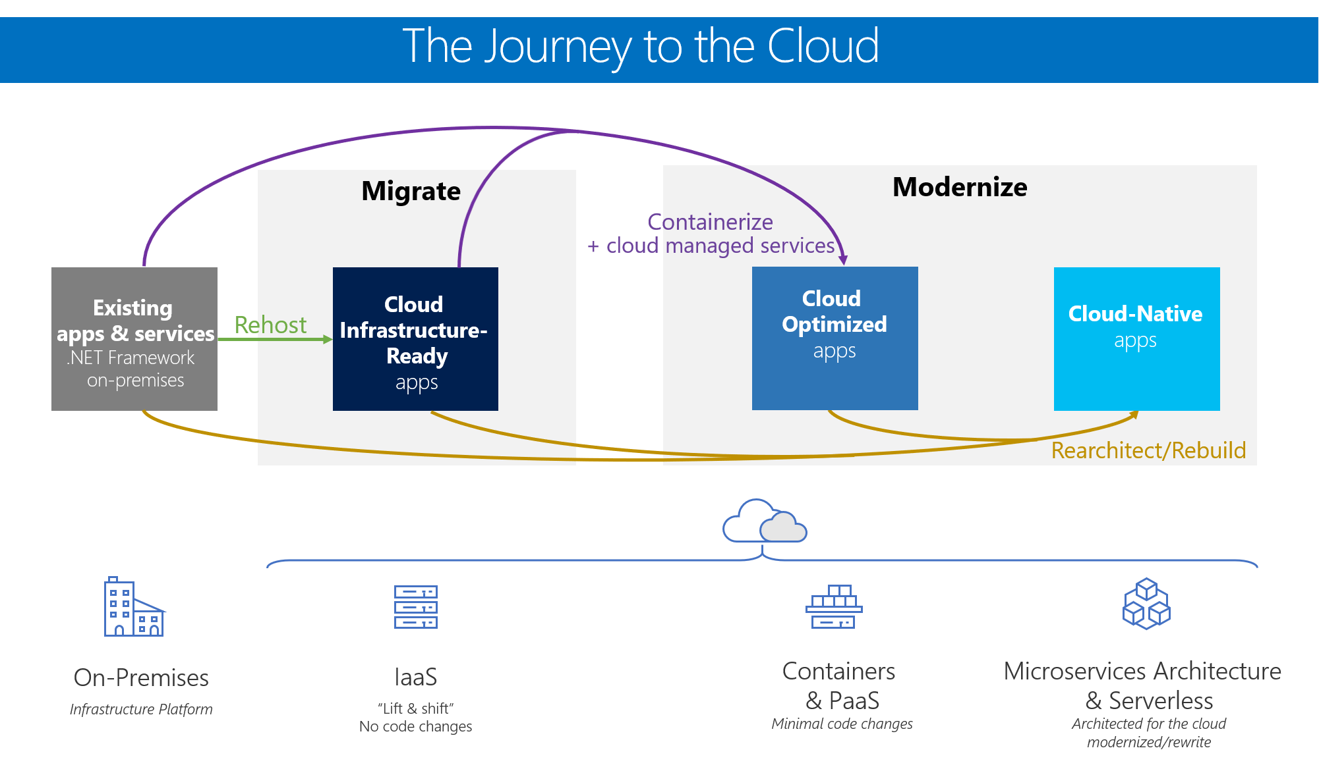
Looking Forward: Cloud Native + On-Prem
Grant-based research is a poor fit for long-term Cloud Computing
Cloud Native is providing a new way of thinking about on-prem infrastructure
On-prem infrastructure, built towards cloud-native solutions allows mobility
Every cloud provider is simply an agility solution going forward

Slide 22
Acknowledgements
CDHI: Rachael Calcutt, Ed Martin, Joe Hesse
SOM Tech: Victor Vargas Reyes, Jamie Lam, Sean Thomas
ARS: Rick Larsen, Sandeep Giri, Scooter Morris
and many funding and resource partners.

Slide 23
Thank You

